Slide 1
Stock Projections to Rebuild WCNPO Striped Marlin Under WCPFC CMM 2024-06
ISC Billfish Working Group
Jon Brodziak
Jon.Brodziak@NOAA.GOV
12-May-2025
Notes:
Update on

Slide 2
Open Science with Documentation and Reproducibility for the ISC Billfish Working Group
This presentation (2025 MLS projections for CMM 24-06.pptx) is on the BILLWG google drive at: https://drive.google.com/drive/folders/1vNBZWGnTDX9_wl-RByhKqA40jsHUOJCy
To access the projection analyses, clone or download the GitHub repository:
https://github.com/PIFSCstockassessments/2024-WCNPO-MLS-Rebuilding
Base case CMM 2024-06 projection results are in the folder:
https://github.com/PIFSCstockassessments/2024-WCNPO-MLS-Rebuilding/tree/main/2025-MLS-projections/output/Base%20Runs

Slide 3
Rebuilding Target

Slide 4
Fishing Mortality

Slide 5
Long-Term Stock-Recruitment Curve from 2023 Assessment

Slide 6
Stock-Recruitment Relationship from 2023 Assessment

Slide 7
CMM 2024-06 Revision to CMM 2010-01 for WCNPO Striped Marlin
Total catch limit of 2400 mt
In 2025-2027, each country can take up to 165 mt of additional catch to their individual limit if the catch limit in 2023-2025 is not reached
In 2023 there was an underage of 826 mt therefore countries are allowed to increase their limit by 165 mt in 2025
Any underage in 2024 can be applied to 2026, and 2025 to 2027
No country is allowed to increase their catch by more than 165 mt
If underage is less than 826 mt, then there will be decisions made about who gets that extra catch
Overage for each country is subtracted from their next year’s individual limit
Link to CMM 2024-06
Country | Catch Limit
Japan | 1454.4mt
Chinese Taipei | 358.4mt
Korea | 214.8mt
United States | 228.4mt
China | 68.8 mt
Other SIDS | 75.2 mt
Total | 2400 mt

Slide 8
Scenario 1. Baseline CMM 2024-06 Catch Limits at 2,400 mt
Country | 2025 | 2026 | 2027
Japan | 1454.4 mt | 1454.4 mt | 1454.4 mt
Chinese Taipei | 358.4 mt | 358.4 mt | 358.4 mt
Korea | 214.8 mt | 214.8 mt | 214.8 mt
United States | 228.4 mt | 228.4 mt | 228.4 mt
China | 68.8 mt | 68.8 mt | 68.8 mt
Other SIDS | 75.2 mt | 75.2 mt | 75.2 mt
Total | 2400 mt | 2400 mt | 2400 mt
For countries which are represented by more than one fleet in the rebuilding analysis, catch would be distributed between fleets based upon the proportion of catch for each fleet in 2020 (last year of the assessment)
For 2021-2022, catch would be updated to reported (yearbook catch) from WCPFC, and 2023-2024 would be carryover catch from 2022 if updated catch is not available.

Slide 9
Scenario 2. CMM 2024-06 Catch Limits with 2025 Carryover Catch
Country | 2025 | 2026 | 2027
Japan | 1454.4 mt + 165 mt | 1454.4 mt | 1454.4 mt
Chinese Taipei | 358.4mt + 165 mt | 358.4 mt | 358.4 mt
Korea | 214.8mt + 165 mt | 214.8 mt | 214.8 mt
United States | 228.4mt + 165 mt | 228.4 mt | 228.4 mt
China | 68.8 mt + 165 mt | 68.8 mt | 68.8 mt
Other SIDS | 75.2 mt | 75.2 mt | 75.2 mt
Total | 3225 mt | 2400 mt | 2400 mt

Slide 10
Scenario 3. CMM 2024-06 Catch Limits with 2025-2026 Carryover Catch
Country | 2025 | 2026 | 2027
Japan | 1454.4 mt + 165 mt | 1454.4 mt + 165 mt | 1454.4 mt
Chinese Taipei | 358.4 mt + 165 mt | 358.4 mt + 165 mt | 358.4 mt
Korea | 214.8 mt + 165 mt | 214.8 mt + 165 mt | 214.8 mt
United States | 228.4 mt + 165 mt | 228.4 mt + 165 mt | 228.4 mt
China | 68.8 mt + 165 mt | 68.8 mt + 165mt | 68.8 mt
Other SIDS | 75.2 mt | 75.2 mt | 75.2 mt
Total | 3225 mt | 3225 mt | 2400 mt

Slide 11
CMM 2024-06 Projection Model Configuration
Initial Conditions – same as in 2024 rebuilding projections
Future Recruitment – same as in 2024 rebuilding projections
Process Error – same as in 2024 rebuilding projections
Fishing Fleets and Selectivities – same as in 2024 rebuilding projections
Catch
Use observed catch in 2021-2024 instead of a status quo fishing mortality
Use catch by Scenario in 2025-2027
Set catch in 2028-2034 to meet rebuilding goal in 2034, noting that
“this CMM shall be reviewed and amended in 2027, pending the completion of a new stock assessment conducted by the ISC.”

Slide 12
Initial Conditions Bootstrap Distribution of Initial Population Size

Slide 13
Recruitment Stock-Recruitment Pattern from 2023 Assessment

Slide 14
Recruitment Trend for Short- and Medium-Term Models

Slide 15
Empirical Cumulative Distribution Functions for Recruitment Under the Short- and Medium-Term Recruitment Models

Slide 16
Process Errors Simulated Natural Mortality at Age

Slide 17
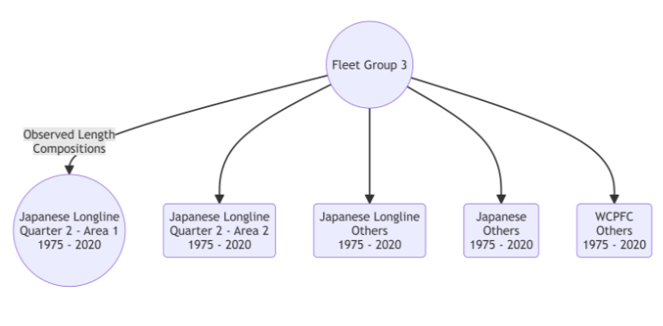
Fleet Groups Japanese Longline Quarter 2 – Area 1 Fleet Group 3

Slide 18
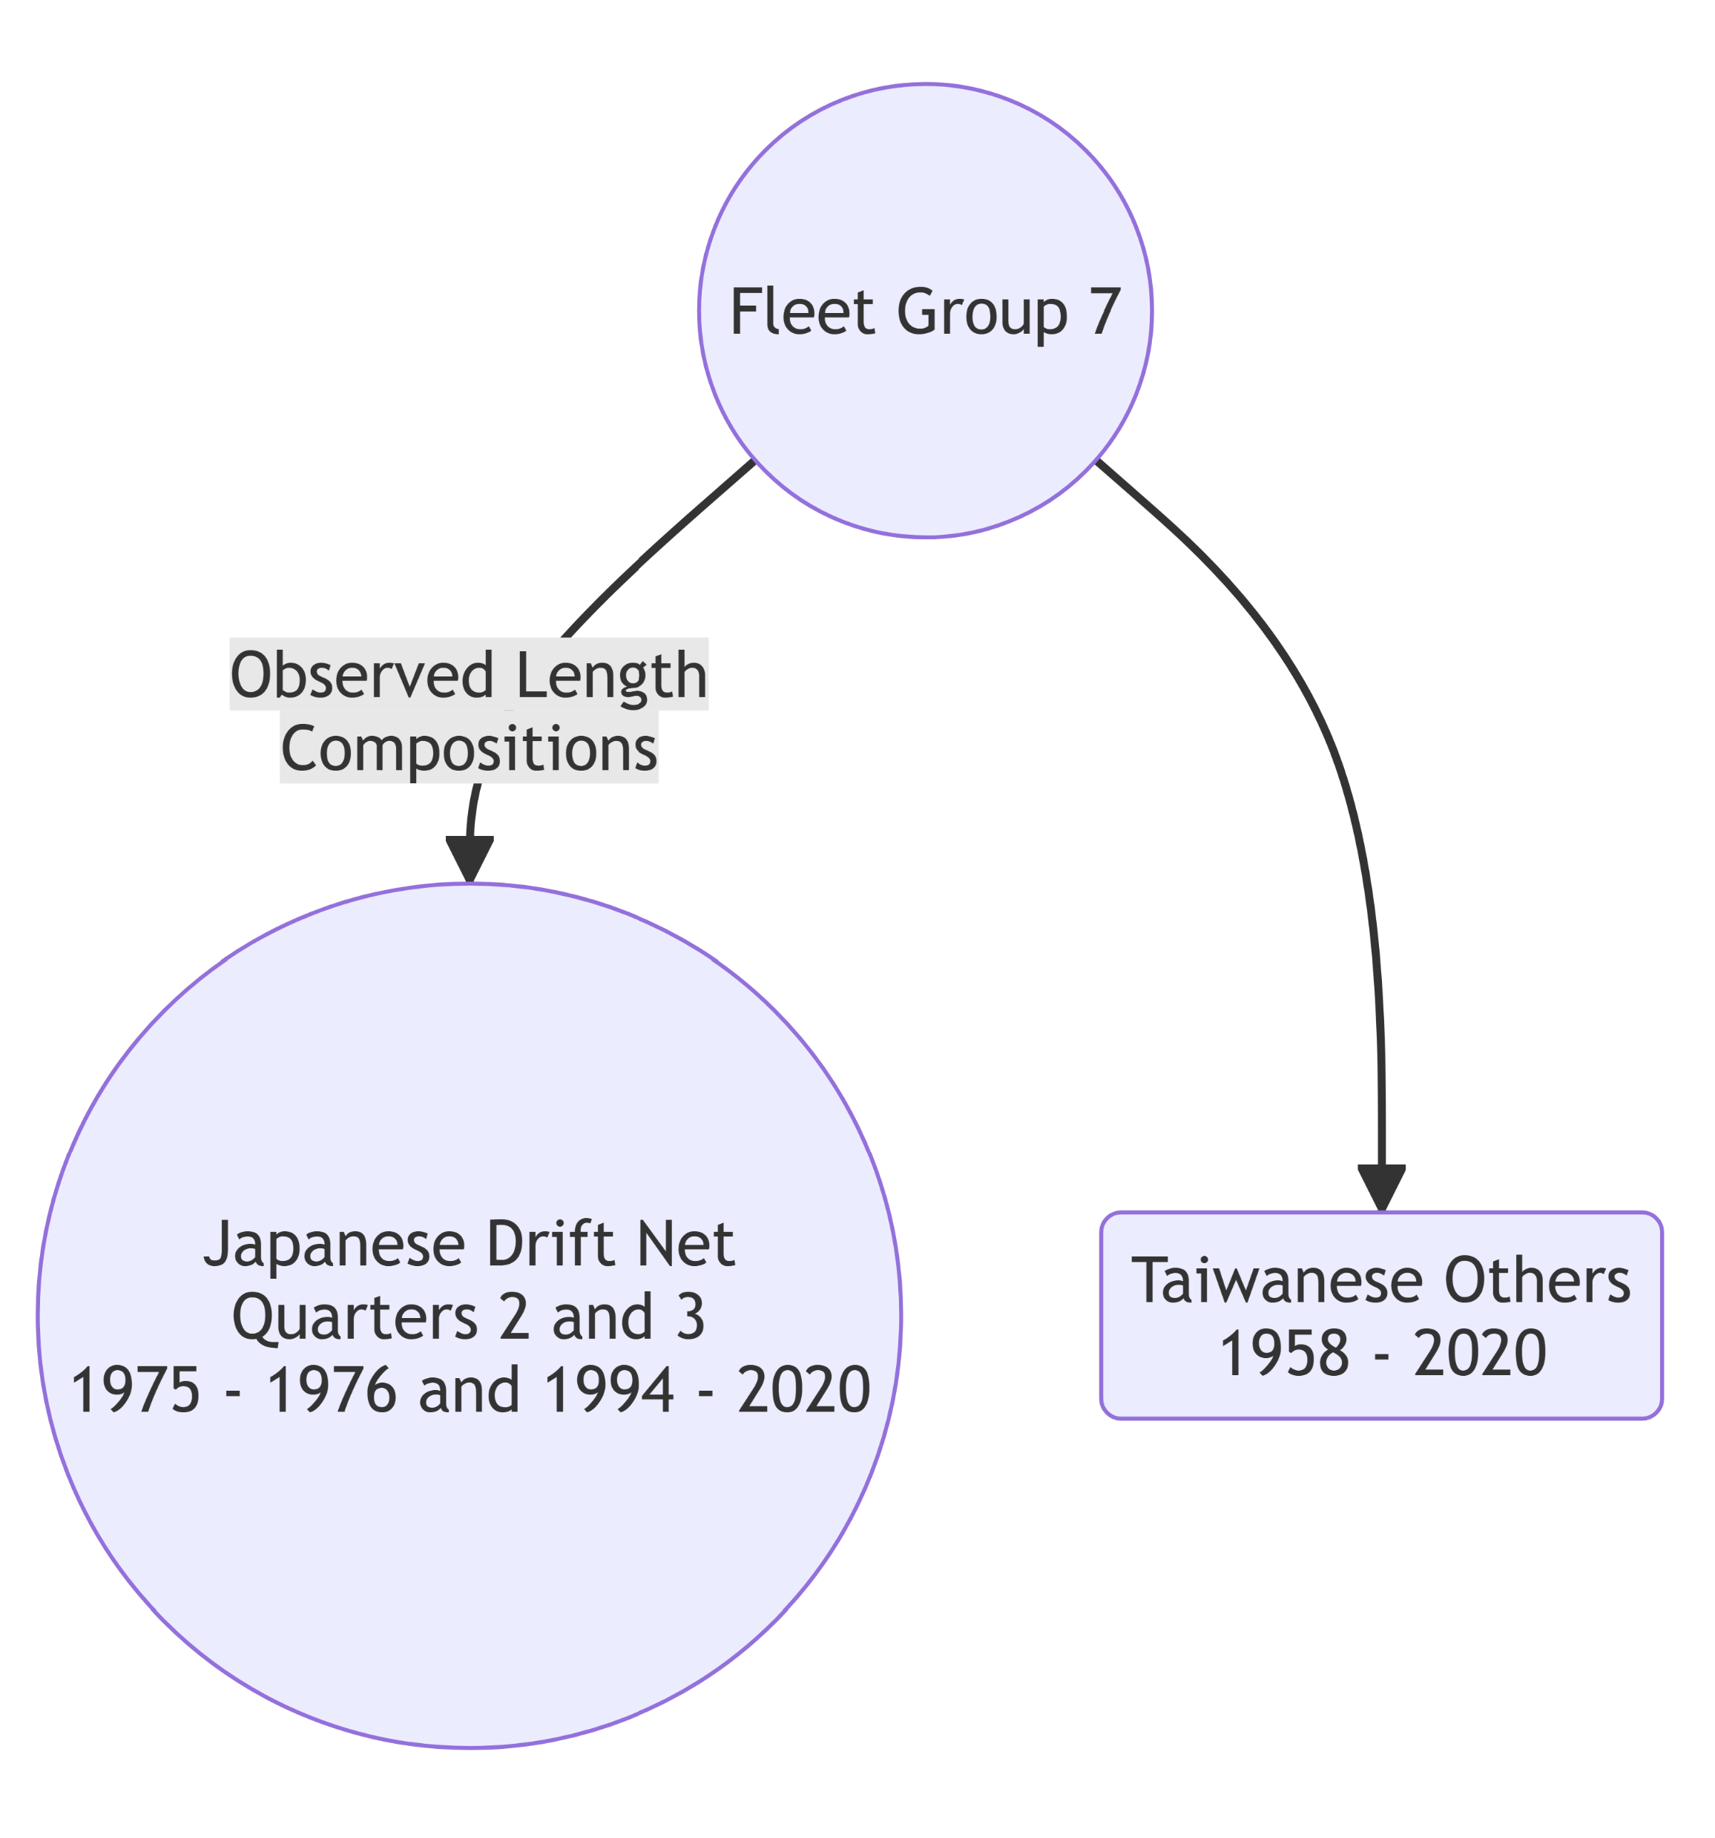
Japanese Driftnet Fleet Group 7

Slide 19
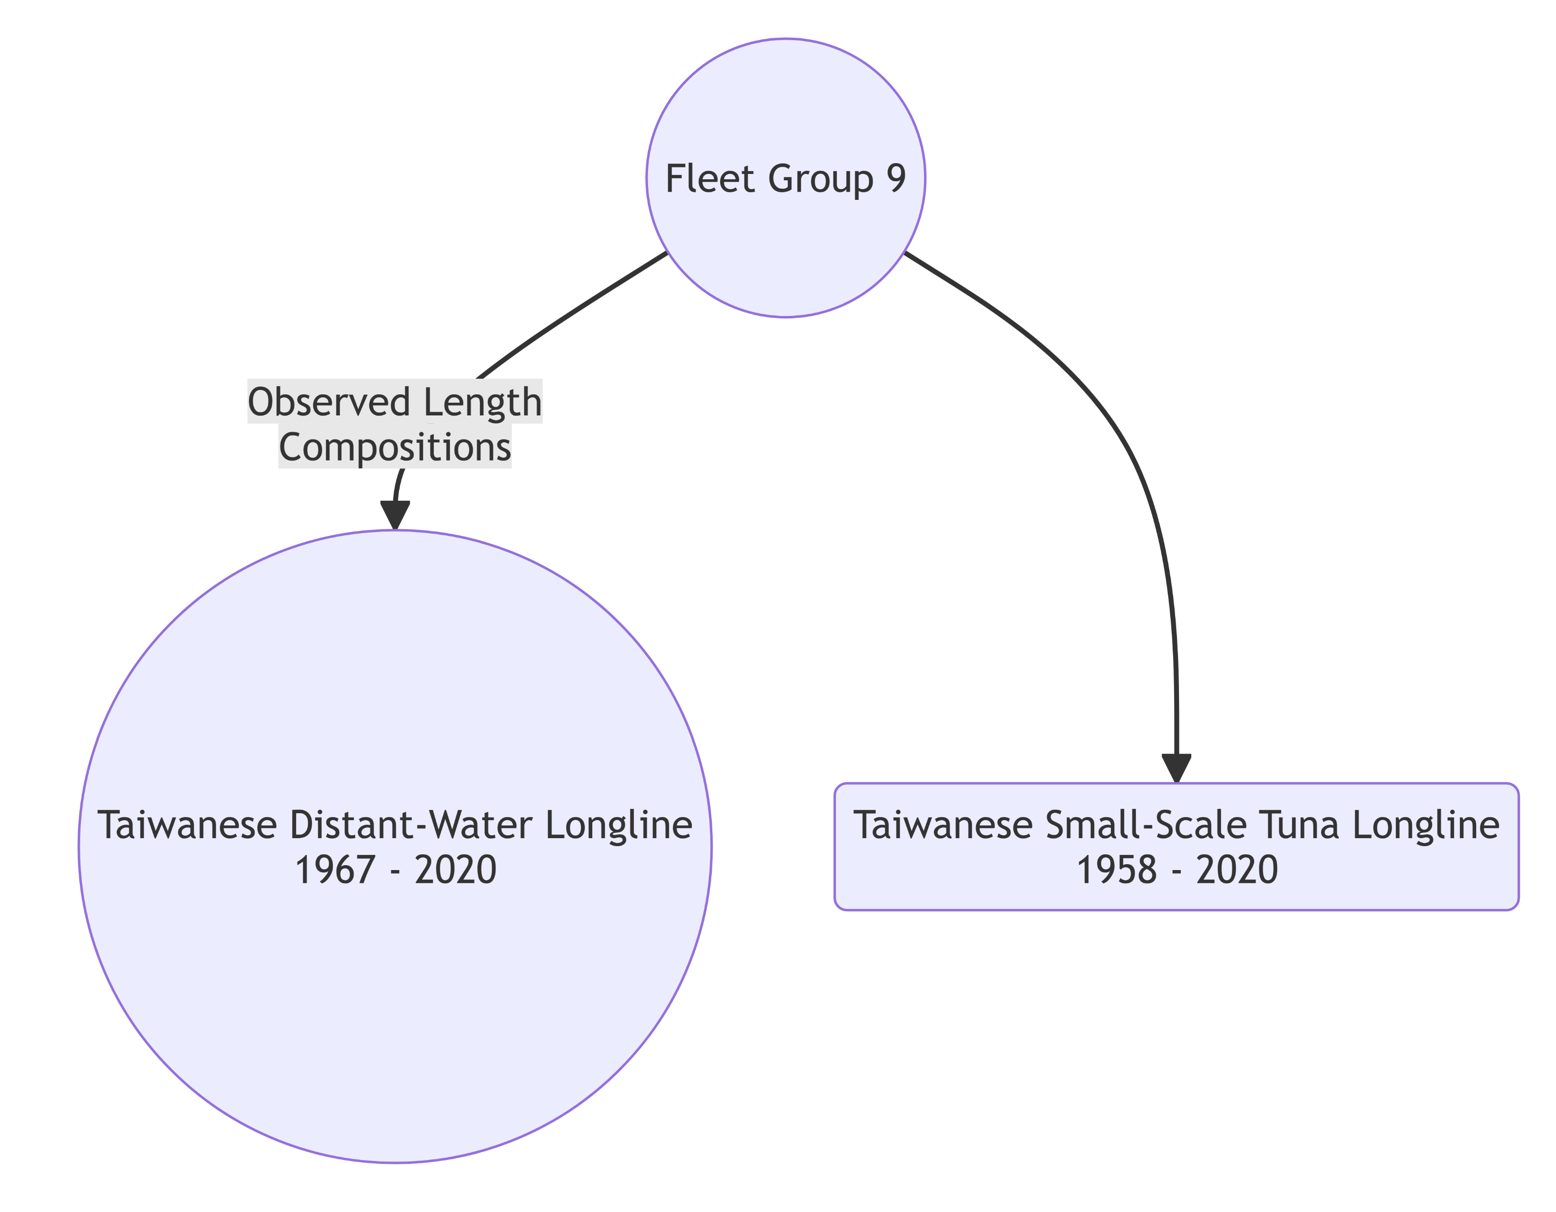
Taiwanese Longline Fleet Group 9

Slide 20
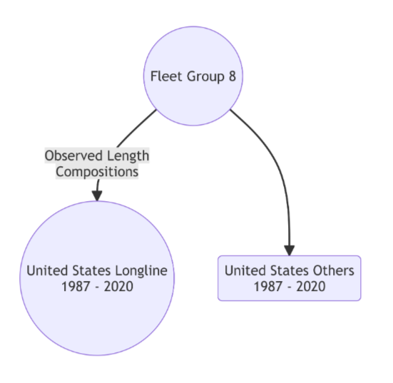
Hawaii Longline Fleet Group 8

Slide 21
Apportion Projected Taiwanese Catch in 2025-2027 to Fleet Groups

Slide 22
Apportion Projected Japanese Catch in 2025-2027 to Fleet Groups

Slide 23
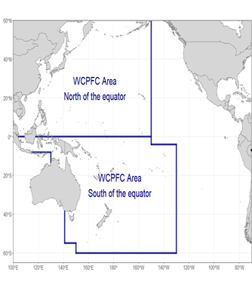
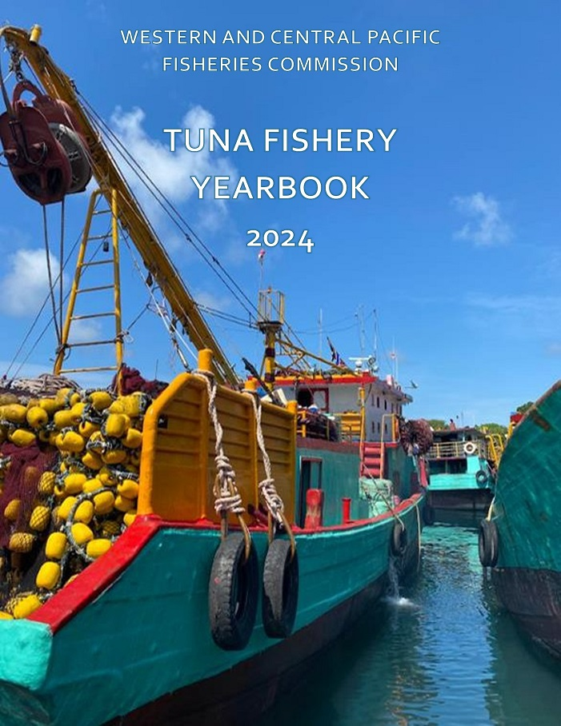
Striped Marin Catches in 2021-2024
Reported Yearbook Catch by CCM in the WCPFC Area

Slide 24
WCPFC Yearbook Reported MLS Catches with Imputed 2024 Catch
Data from XLS_NorthWCPFC.csv

Slide 25
WCPFC Yearbook Reported MLS Catch with Imputed 2024 Catch
Data from XLS_NorthWCPFC.csv

Slide 26
Reported MLS Catch from Japan
Data from ISC Billfish Working Group

Slide 27
Reported MLS Catch from the United States
Data from ISC Billfish Working Group

Slide 28
Initial Catches are Lower for the CMM 2024-06 Projection Scenarios

Slide 29
Initial Fishing Mortalities are Lower for the CMM 2024-06 Scenarios

Slide 30
Striped Marlin Catch in 2025-2027
Catch Limits with No Carryover

Slide 31
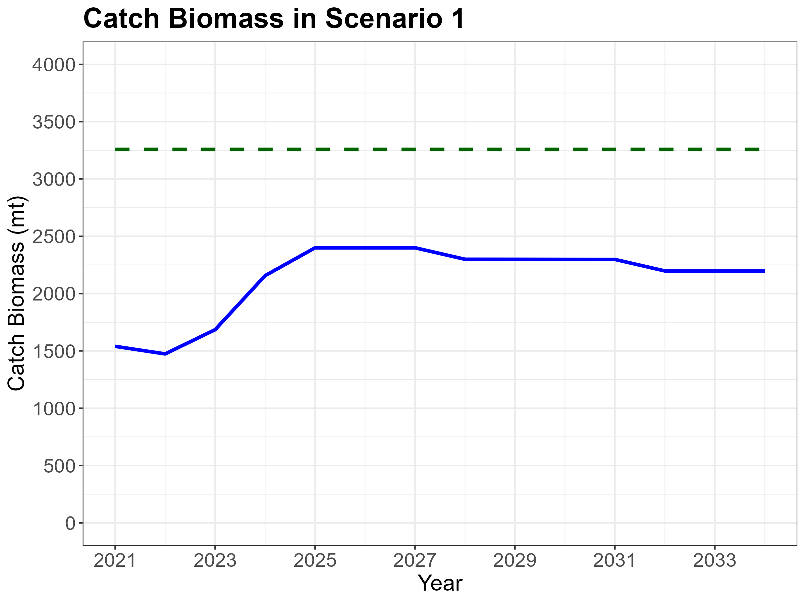

Slide 32
Striped Marlin Catch in 2025-2027
Catch Limits with Carryover in 2025

Slide 33
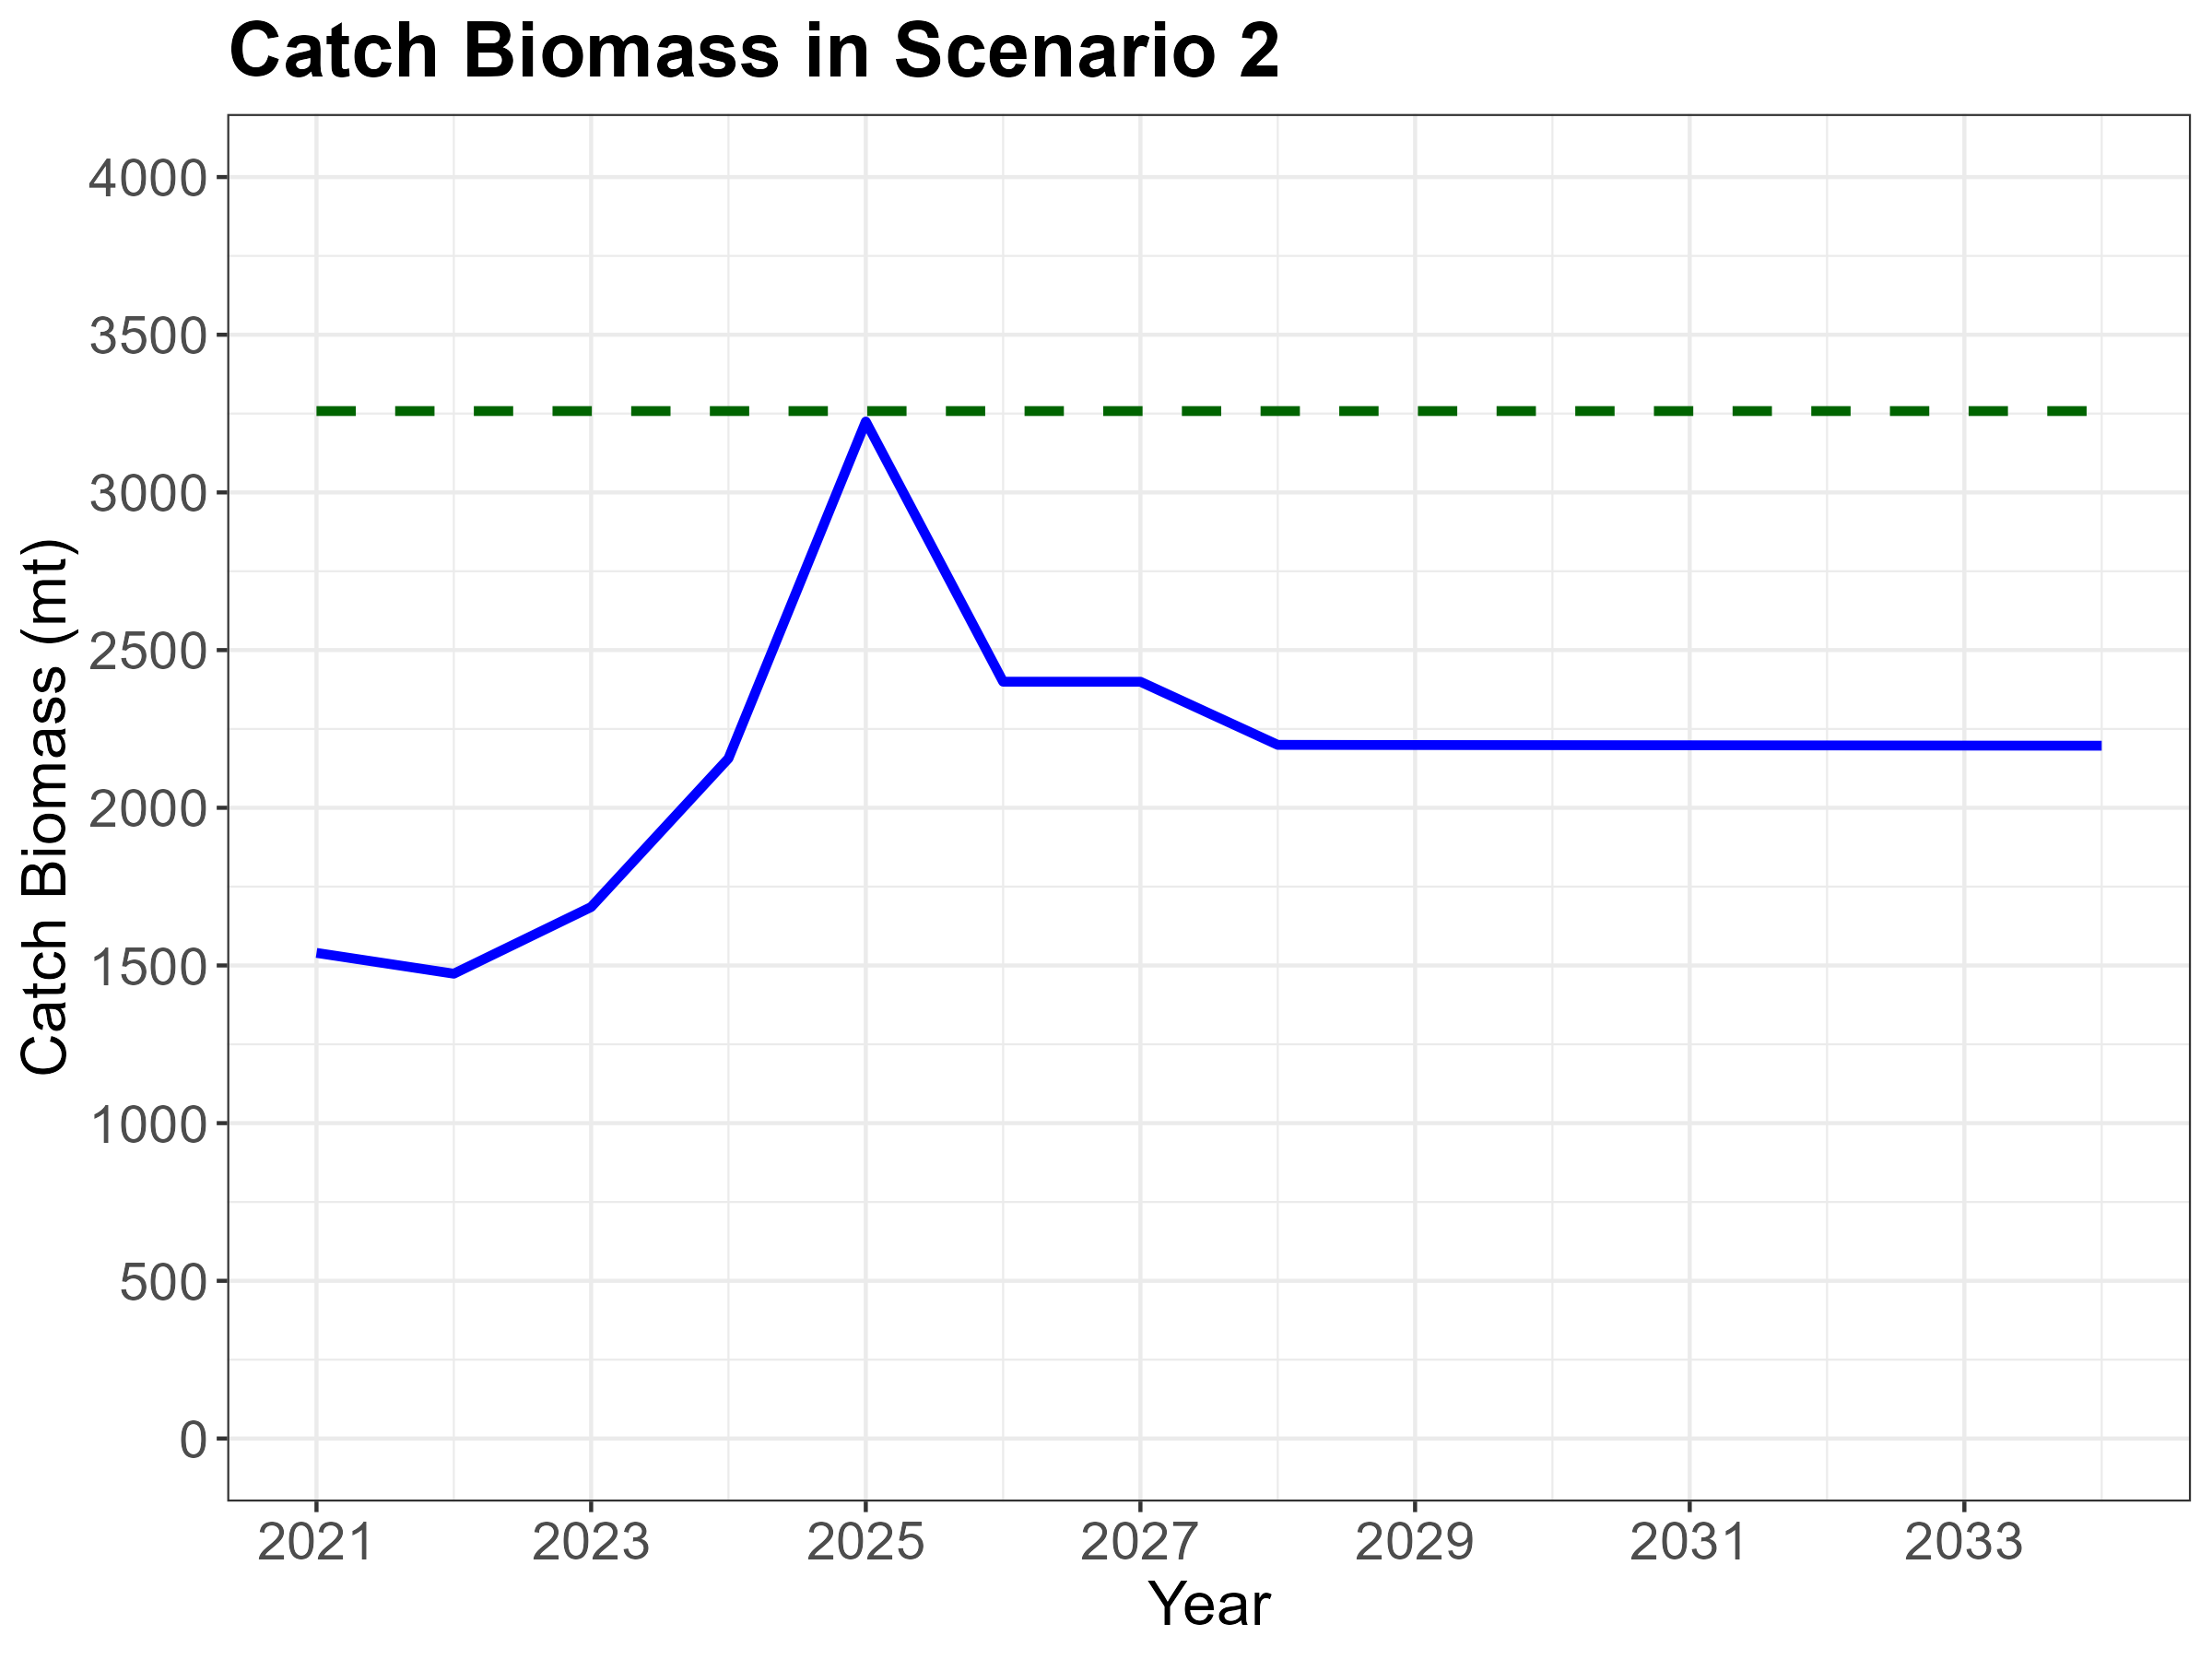

Slide 34
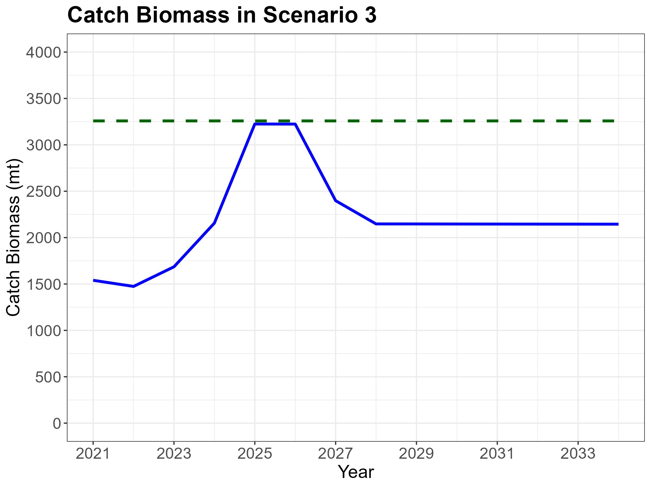

Slide 35
CMM 2024-06 Projection Results
Spawning Biomass Distributions
Rebuilding Probabilities
Fishing Mortality Distributions
Overfishing Probabilities
Three Periods
Initialization: 2021-2024
CMM 2024-06: 2025-2027
Post CMM 2024-06: 2028-2034

Slide 40
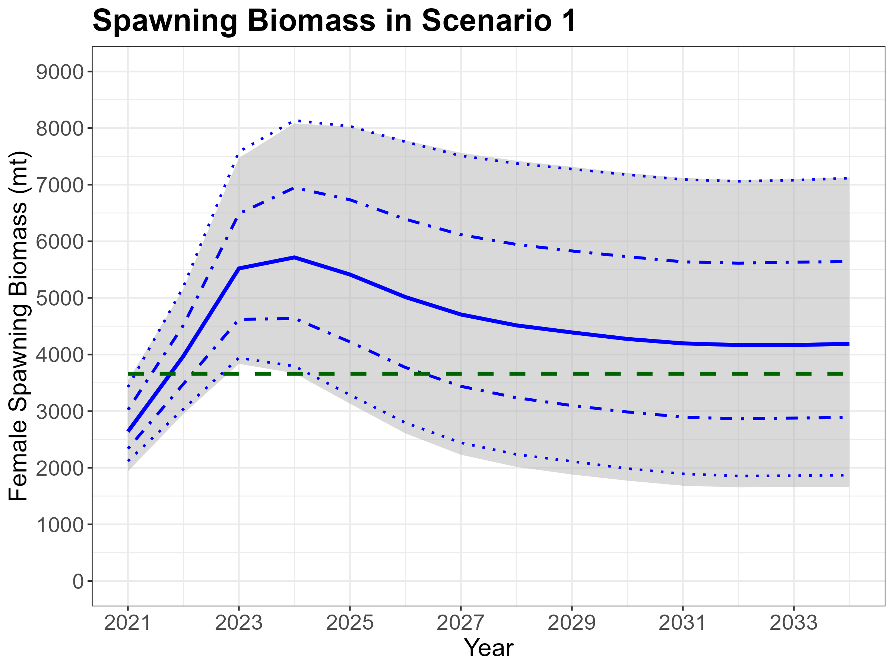

Slide 41
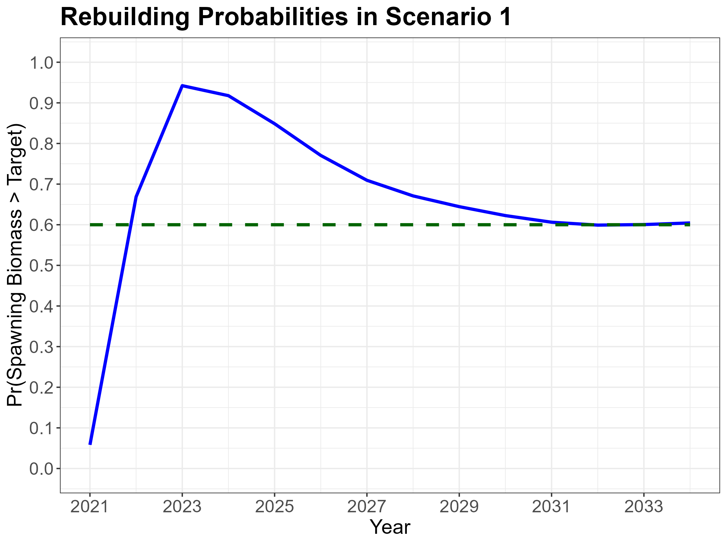

Slide 42
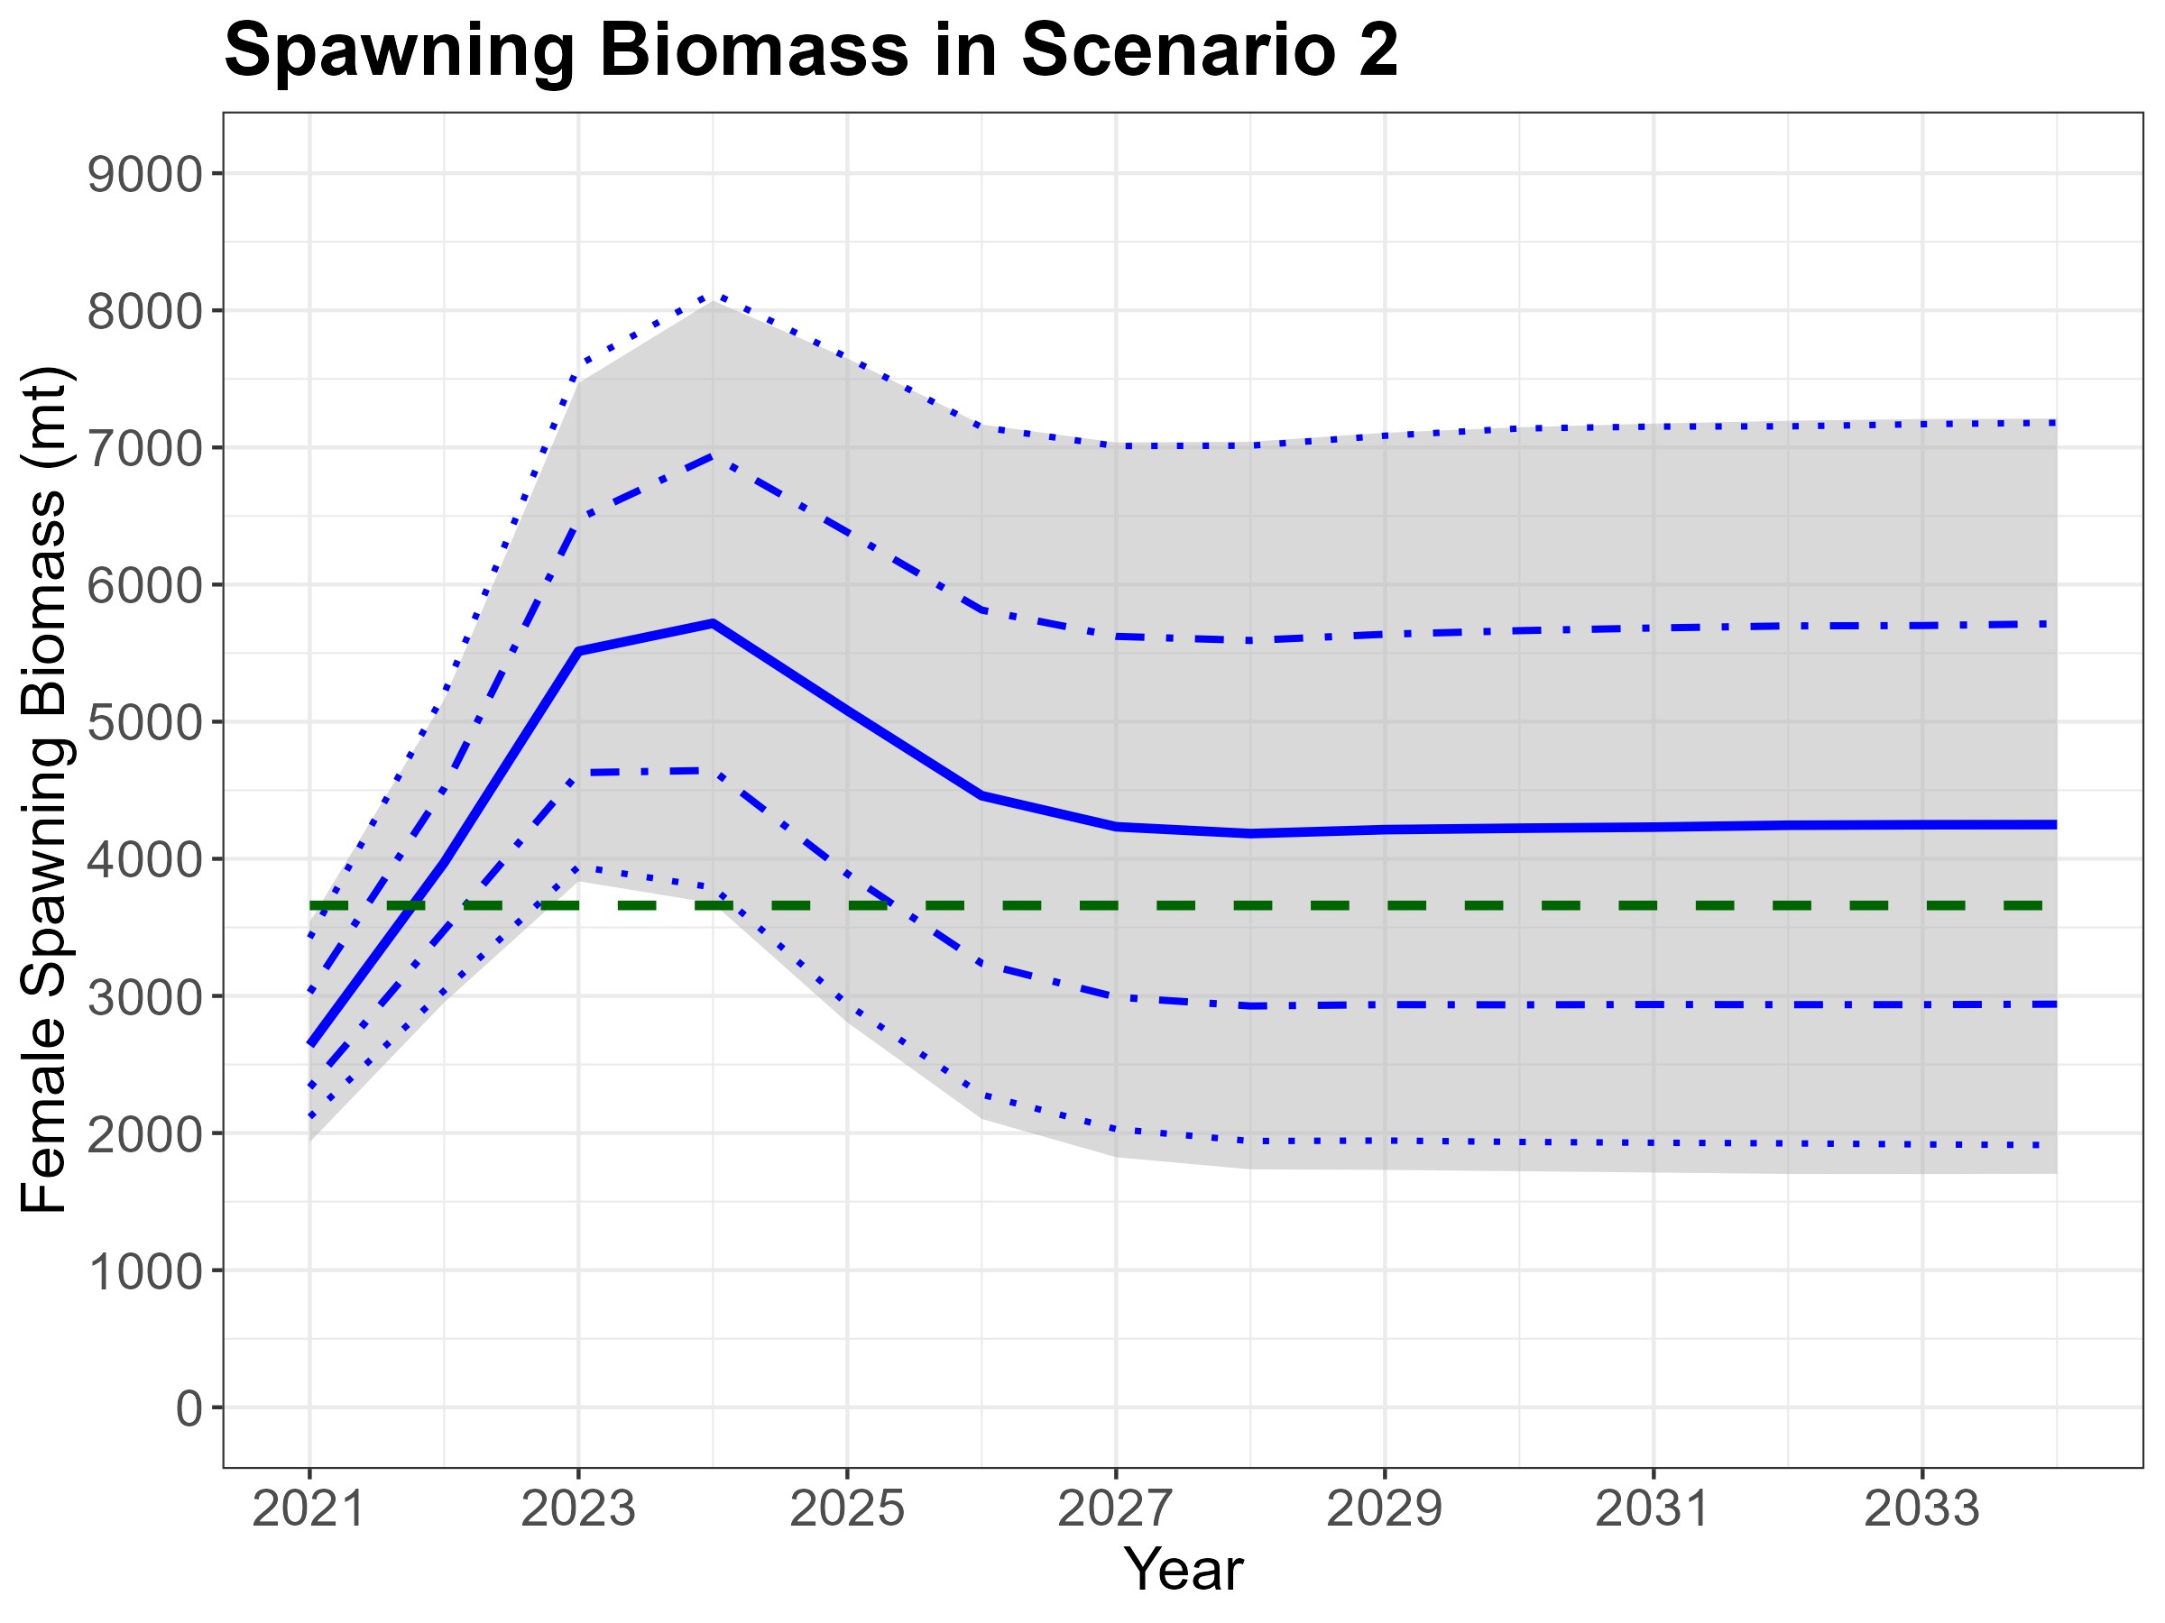

Slide 43
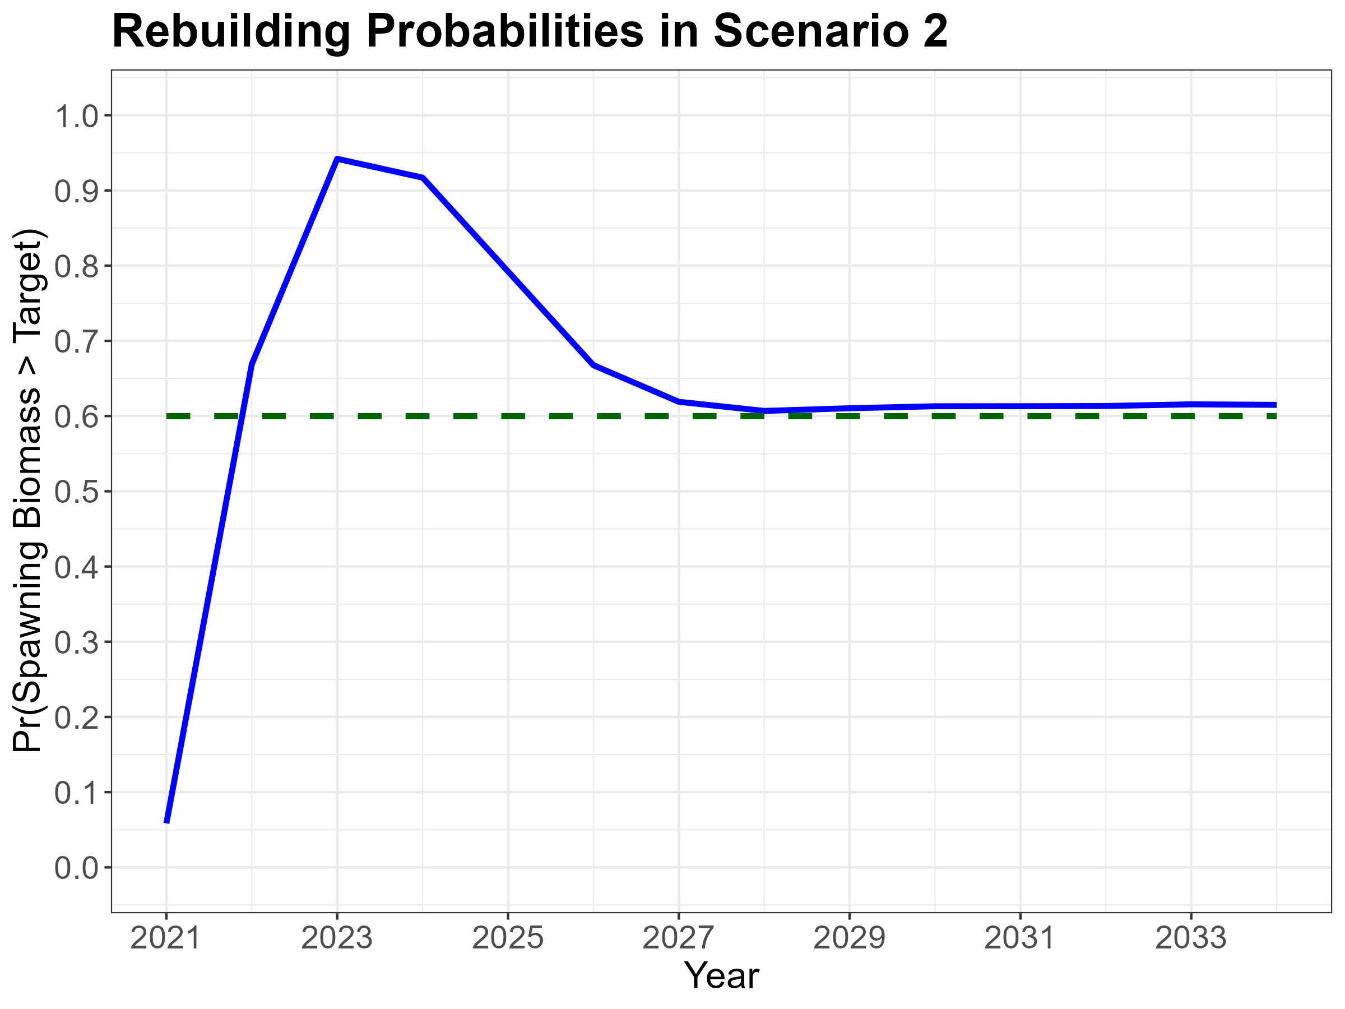

Slide 44
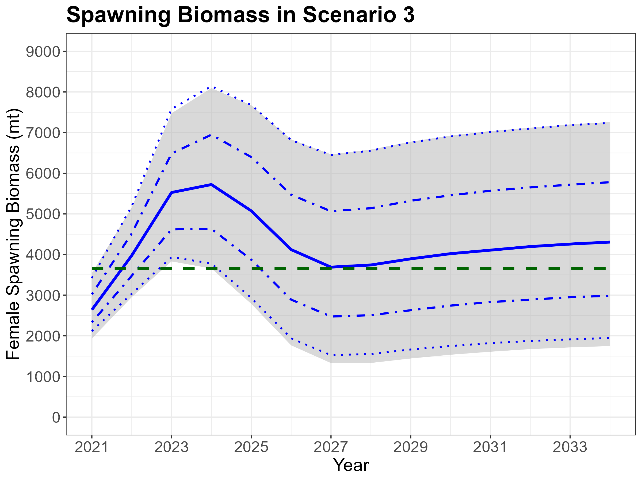

Slide 45
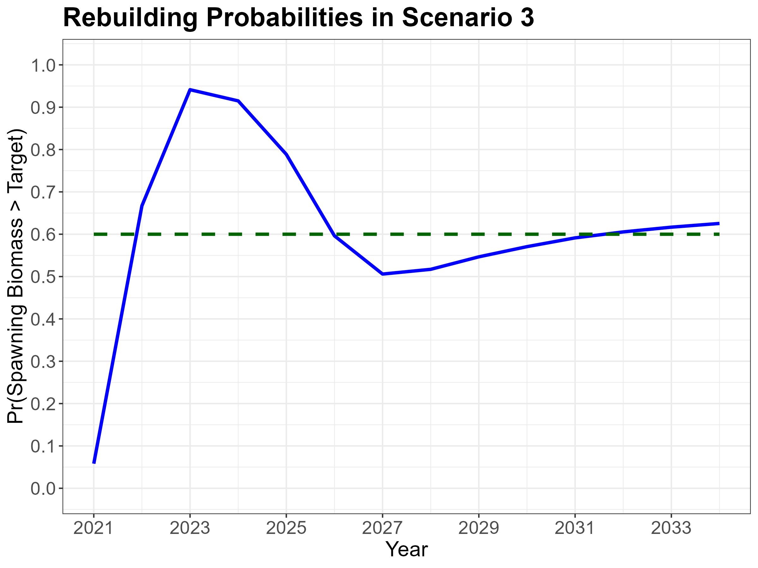

Slide 50
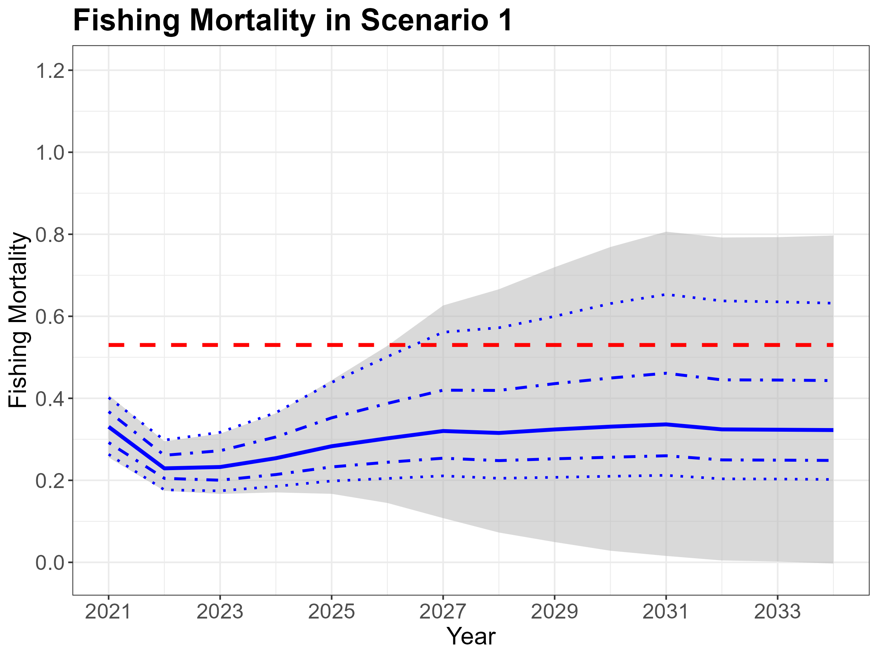

Slide 51
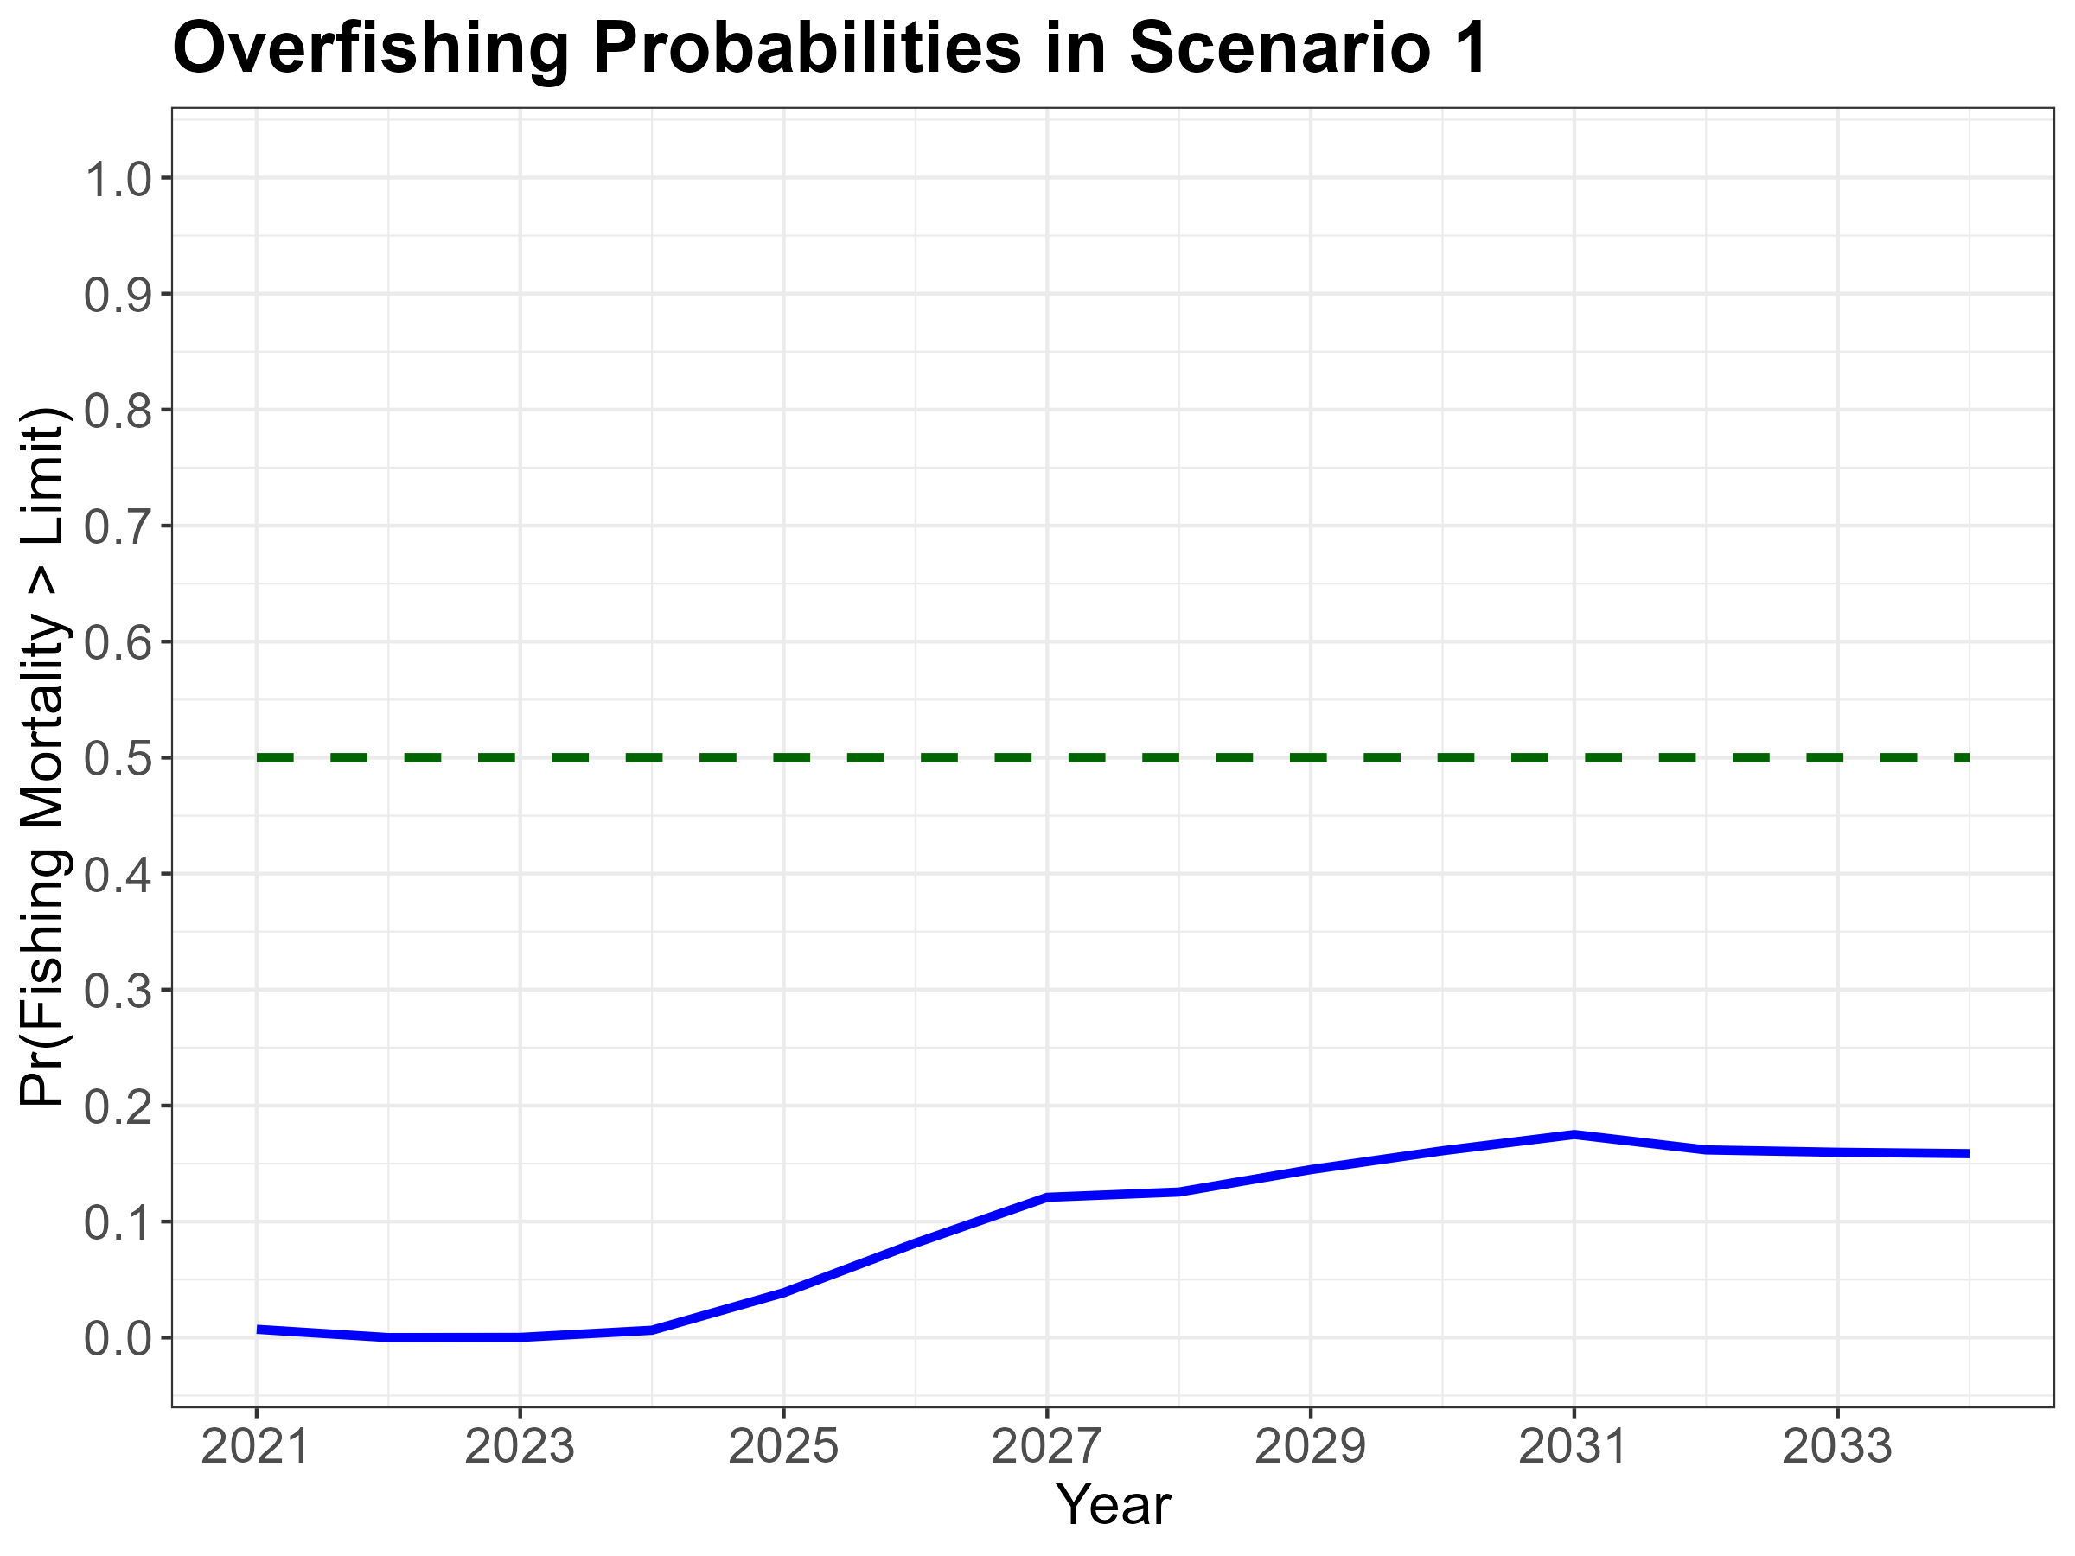

Slide 52
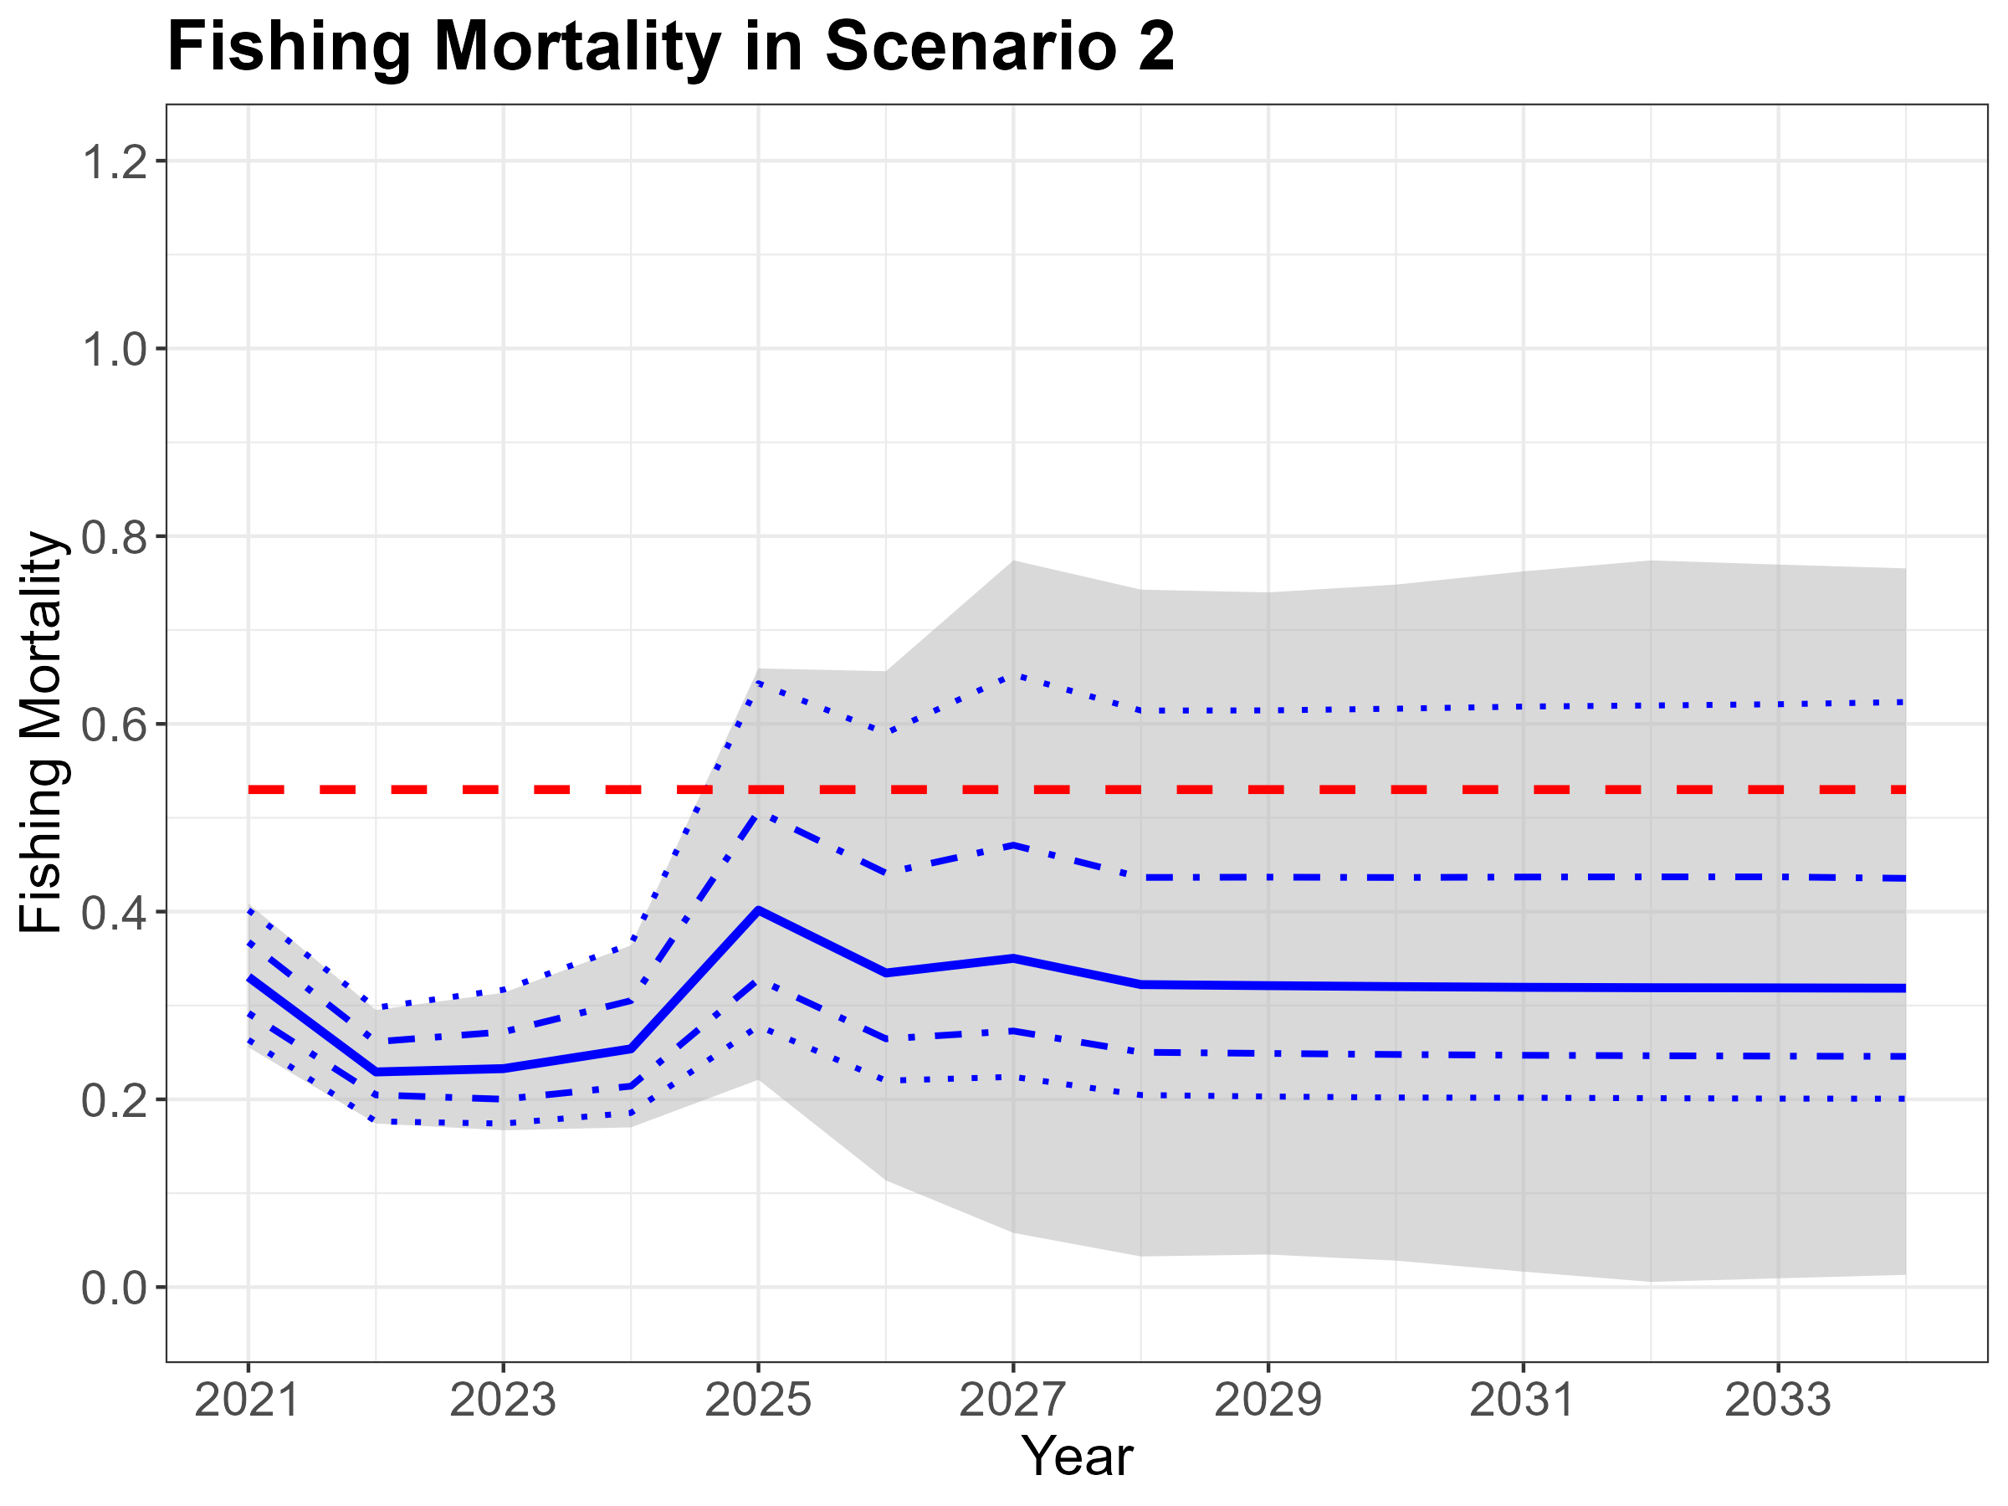

Slide 53
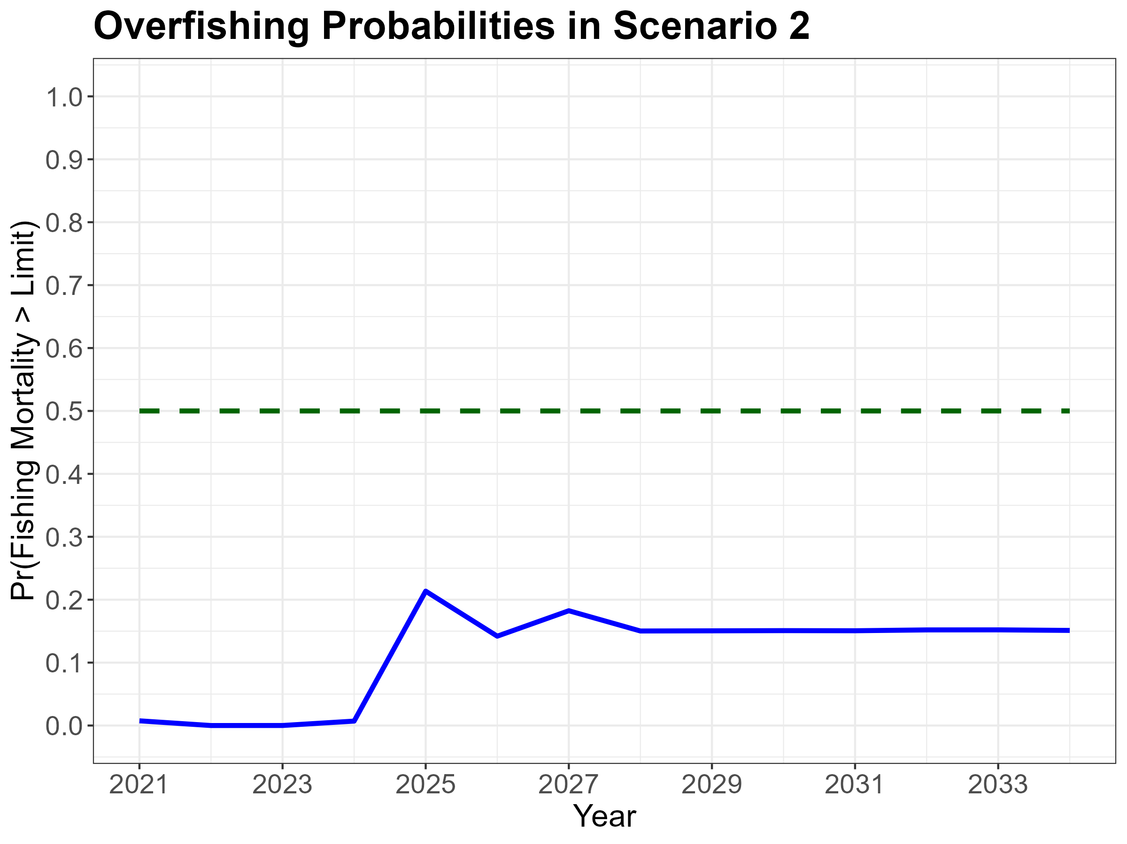

Slide 54
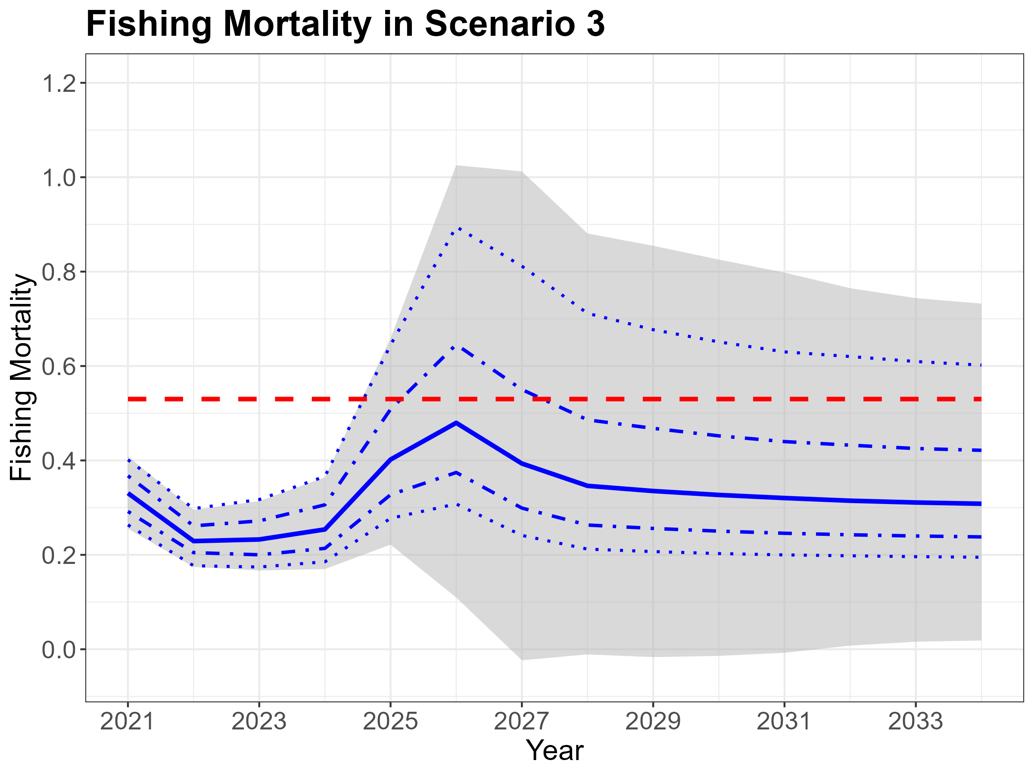

Slide 55
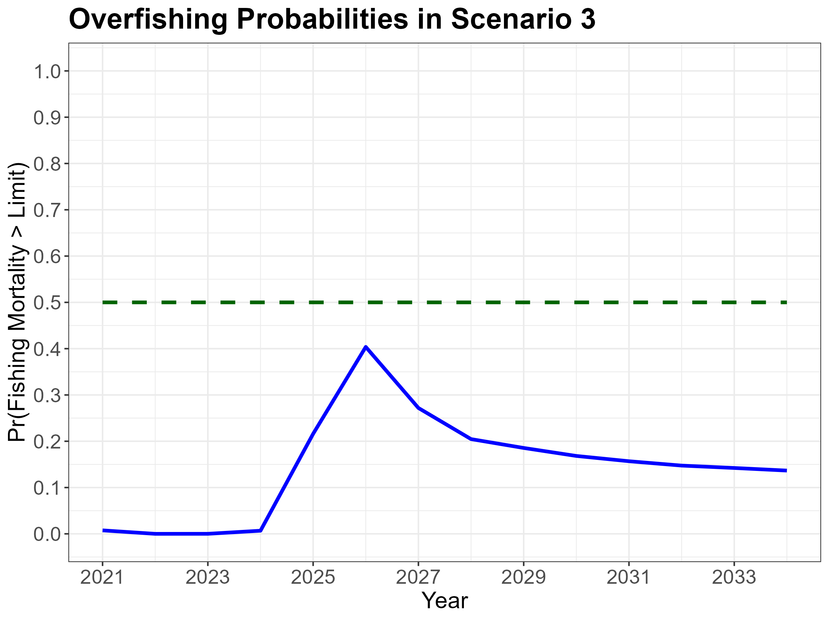

Slide 56
Summary of CMM 2024-06 Projection Results
WCNPO striped marlin likely achieved biomass target in 2023 and very likely achieved target in 2024 under each scenario
Factors affecting rebuilding results in comparison to 2024 rebuilding projections
Reduction in 2021-2024 catches of about 50% from the predicted catches in 2024 projections
Spawning biomass increase due to above-average 2018-2020 year classes maturing in 2021-2024
Allowance for carryover catches under CMM 2024-06 increases uncertainty in projected outcomes
Lastly noting that CMM 2024-06 states that “this CMM shall be reviewed and amended in 2027, pending the completion of a new stock assessment conducted by the ISC.”

Slide 57
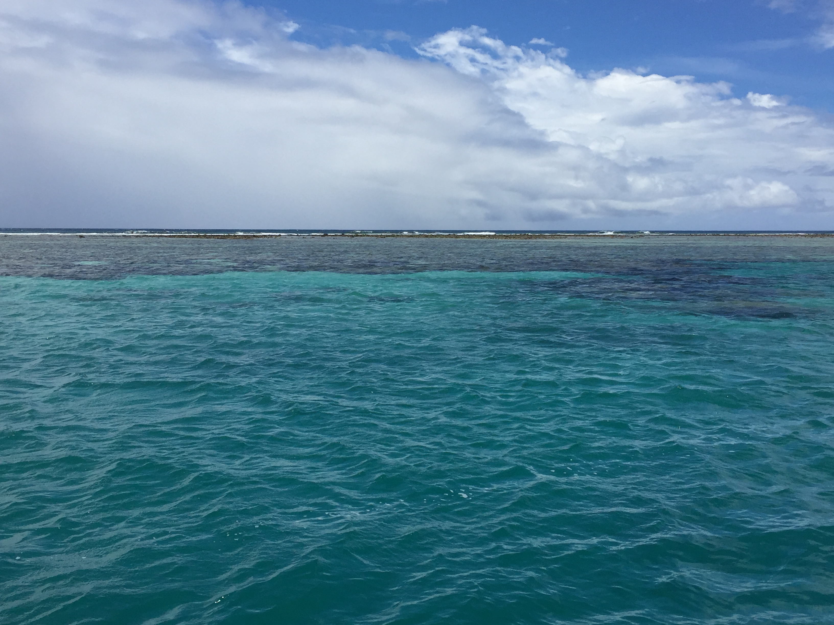
Auxiliary Slides

Slide 58
MLS Year Classes in 2018-2020 Were Above Short-Term Average

Slide 59
MLS Catches in 2021-2023 Were the Lowest Observed Since 1977

Slide 60
What is the Abundance of the 2020 Year Class ?

Slide 61
What is the Abundance of the 2020 Year Class ?

Slide 62
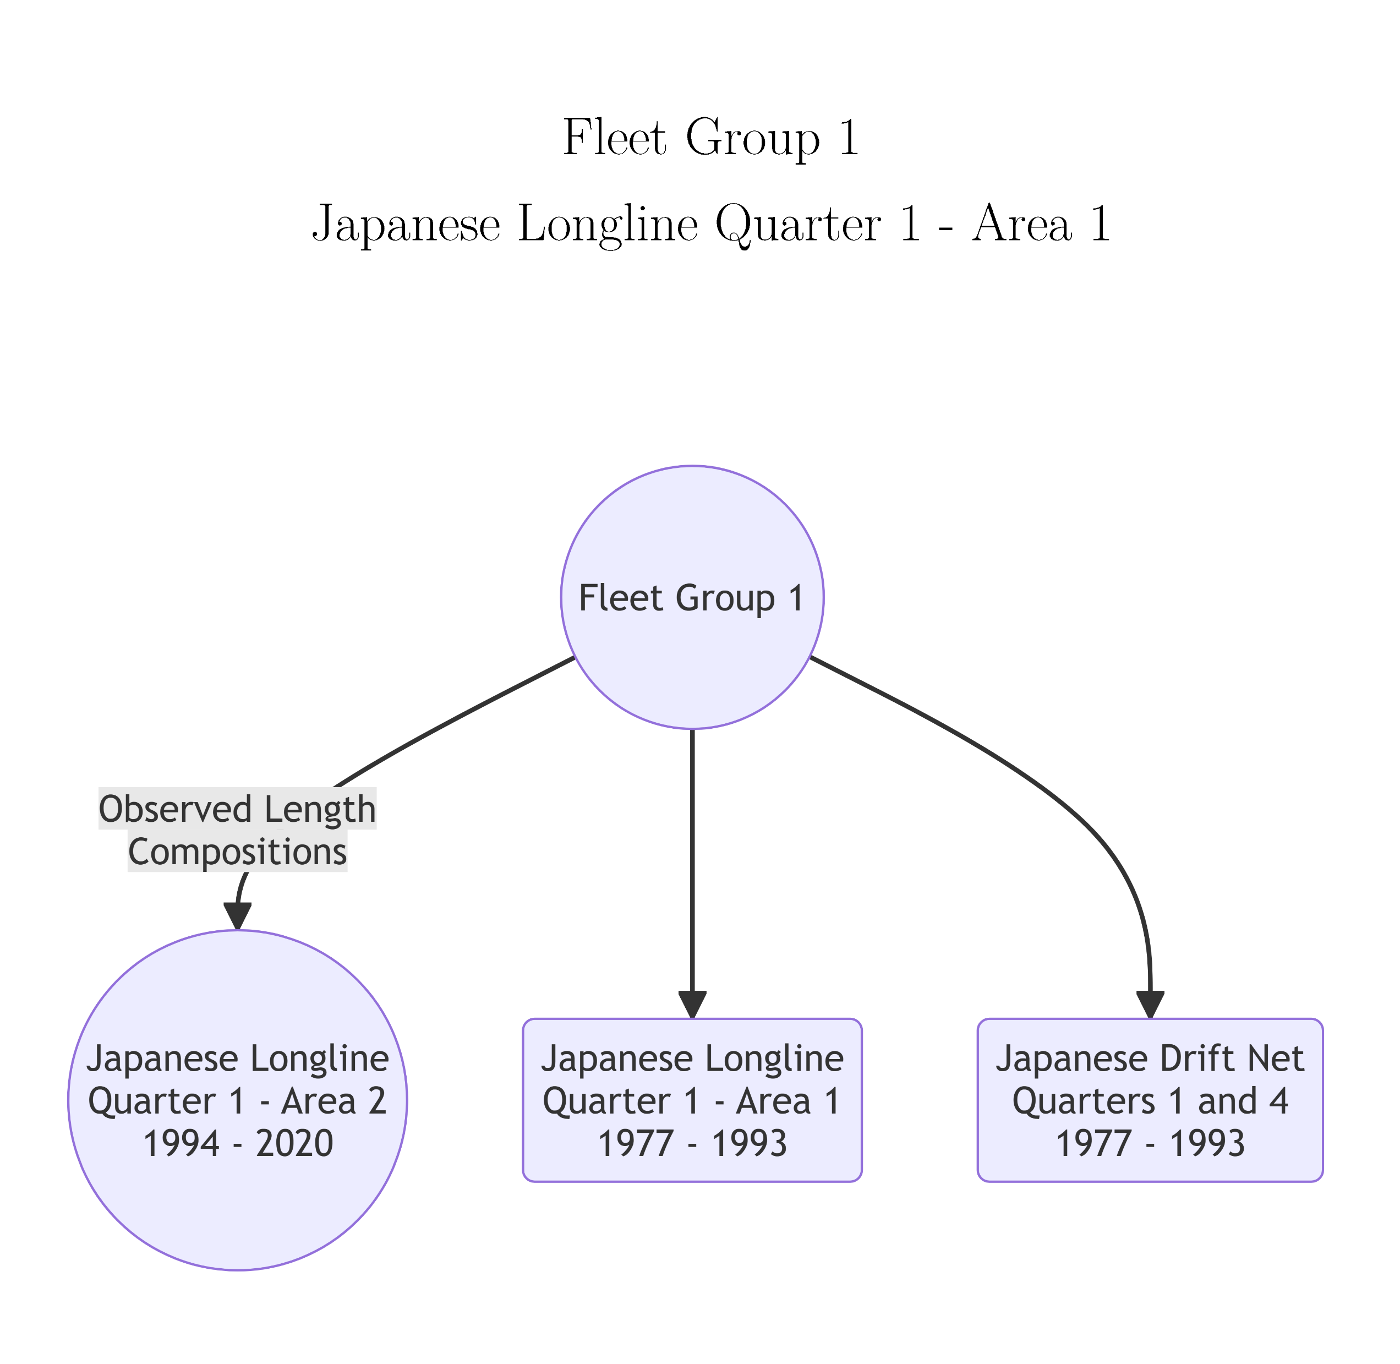
Fleet Groups with Identical Fishery Selectivity for Striped Marlin

Slide 63
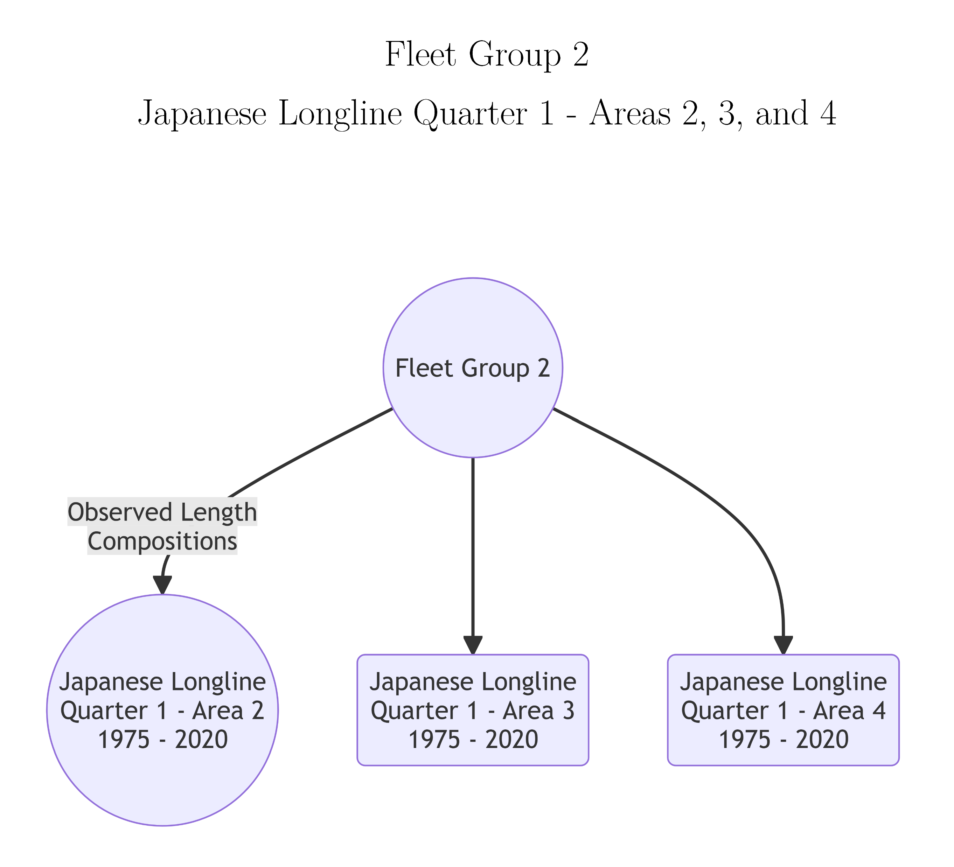
Fleet Groups with Identical Fishery Selectivity for Striped Marlin

Slide 64
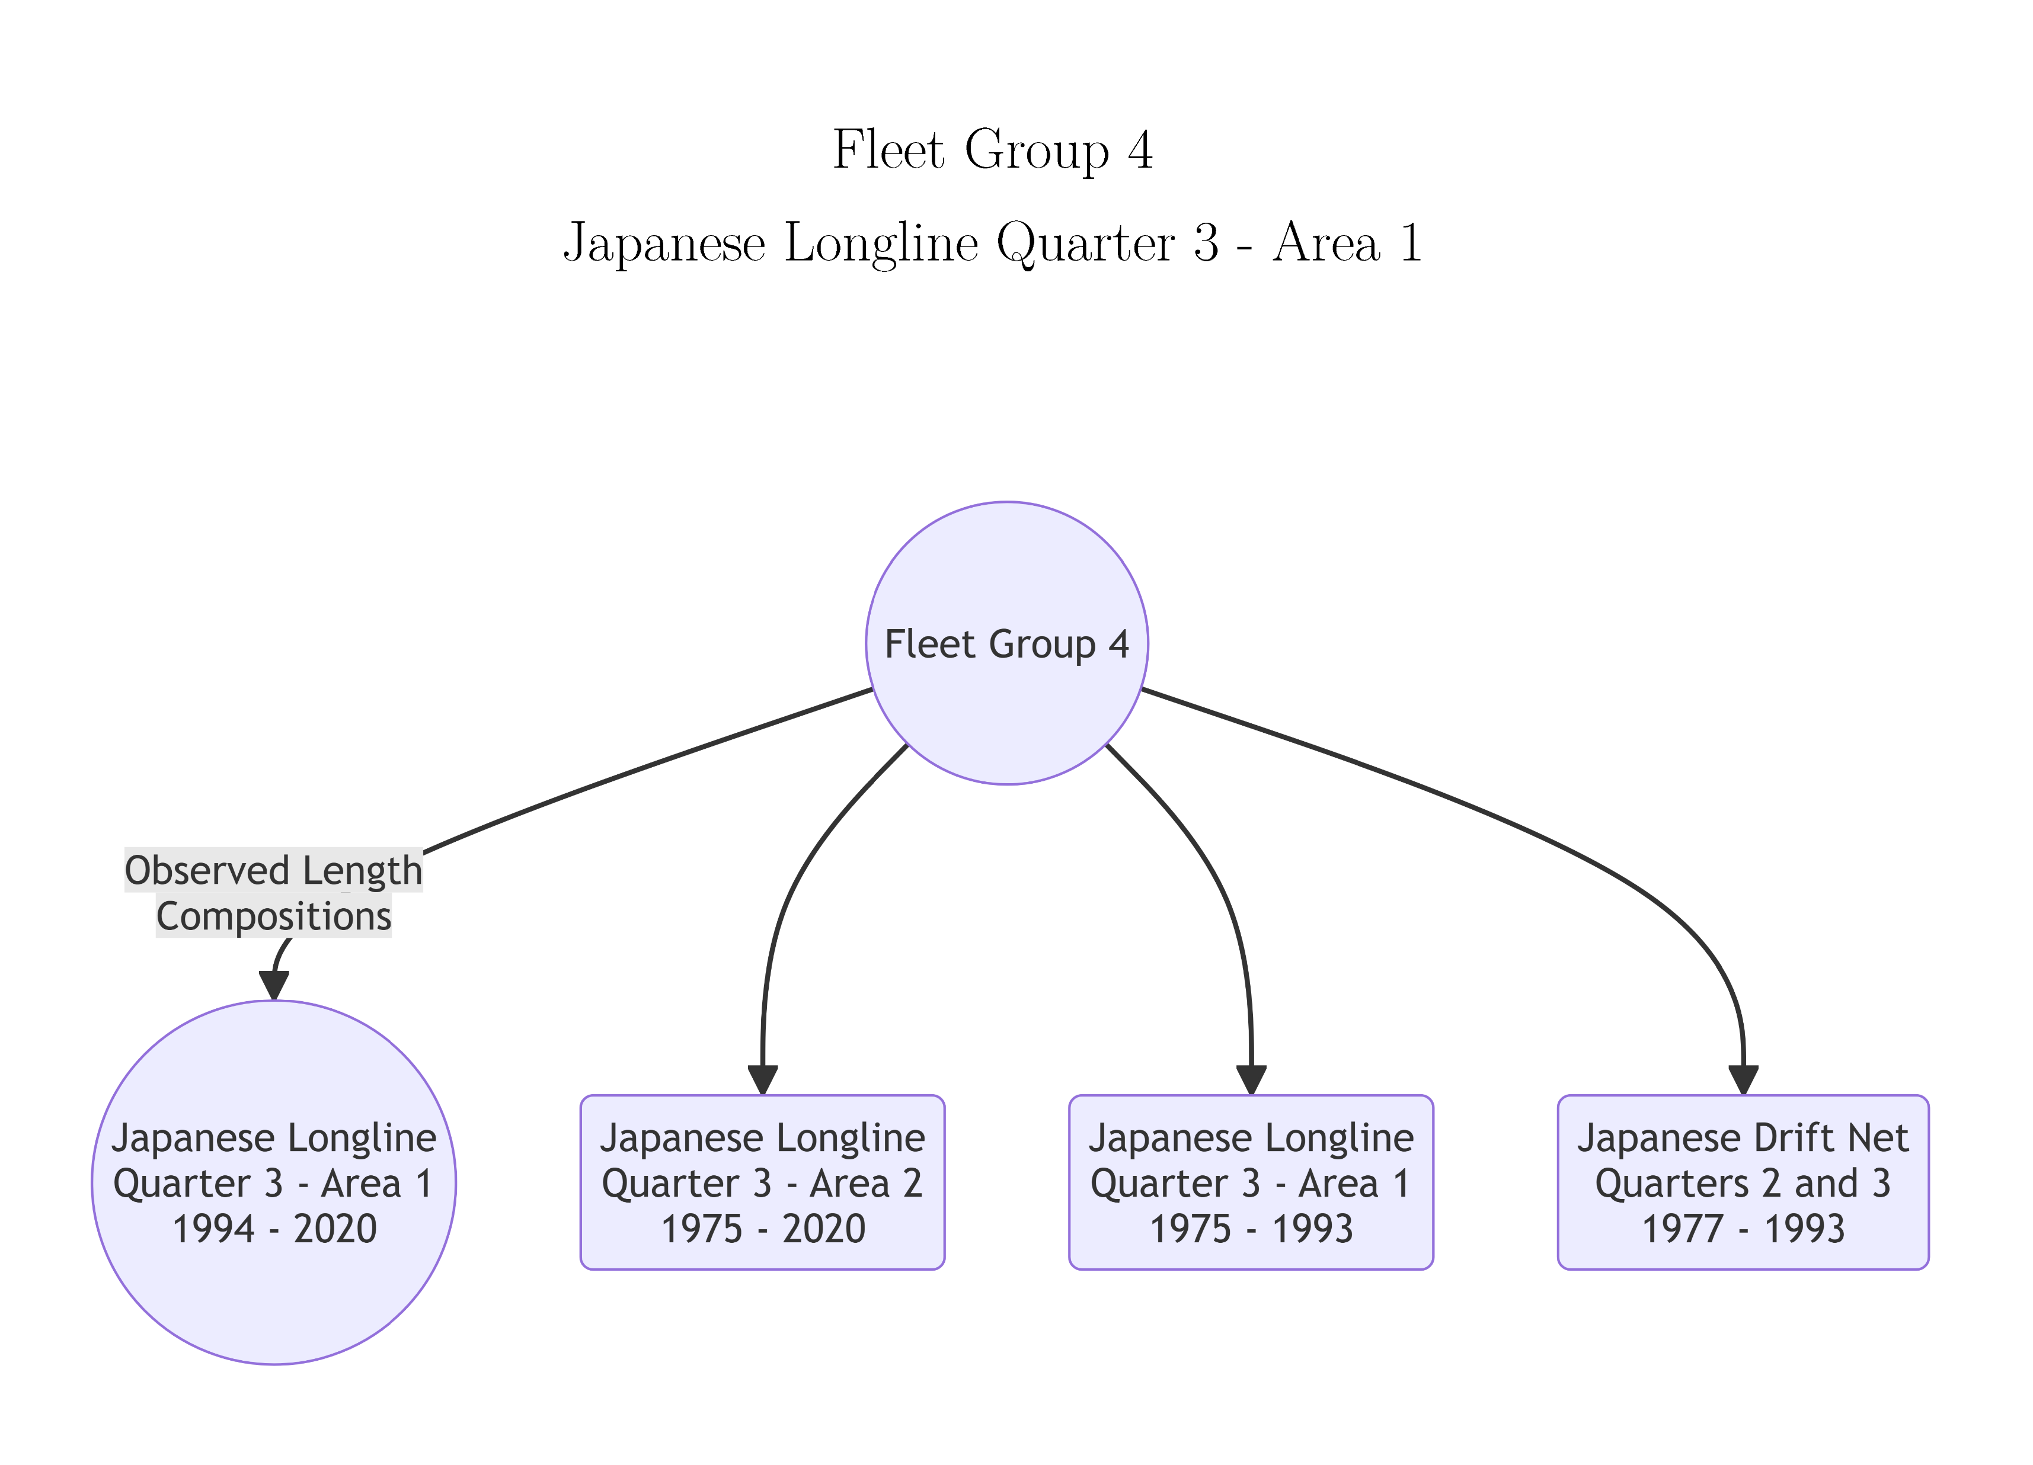
Fleet Groups with Identical Fishery Selectivity for Striped Marlin

Slide 65
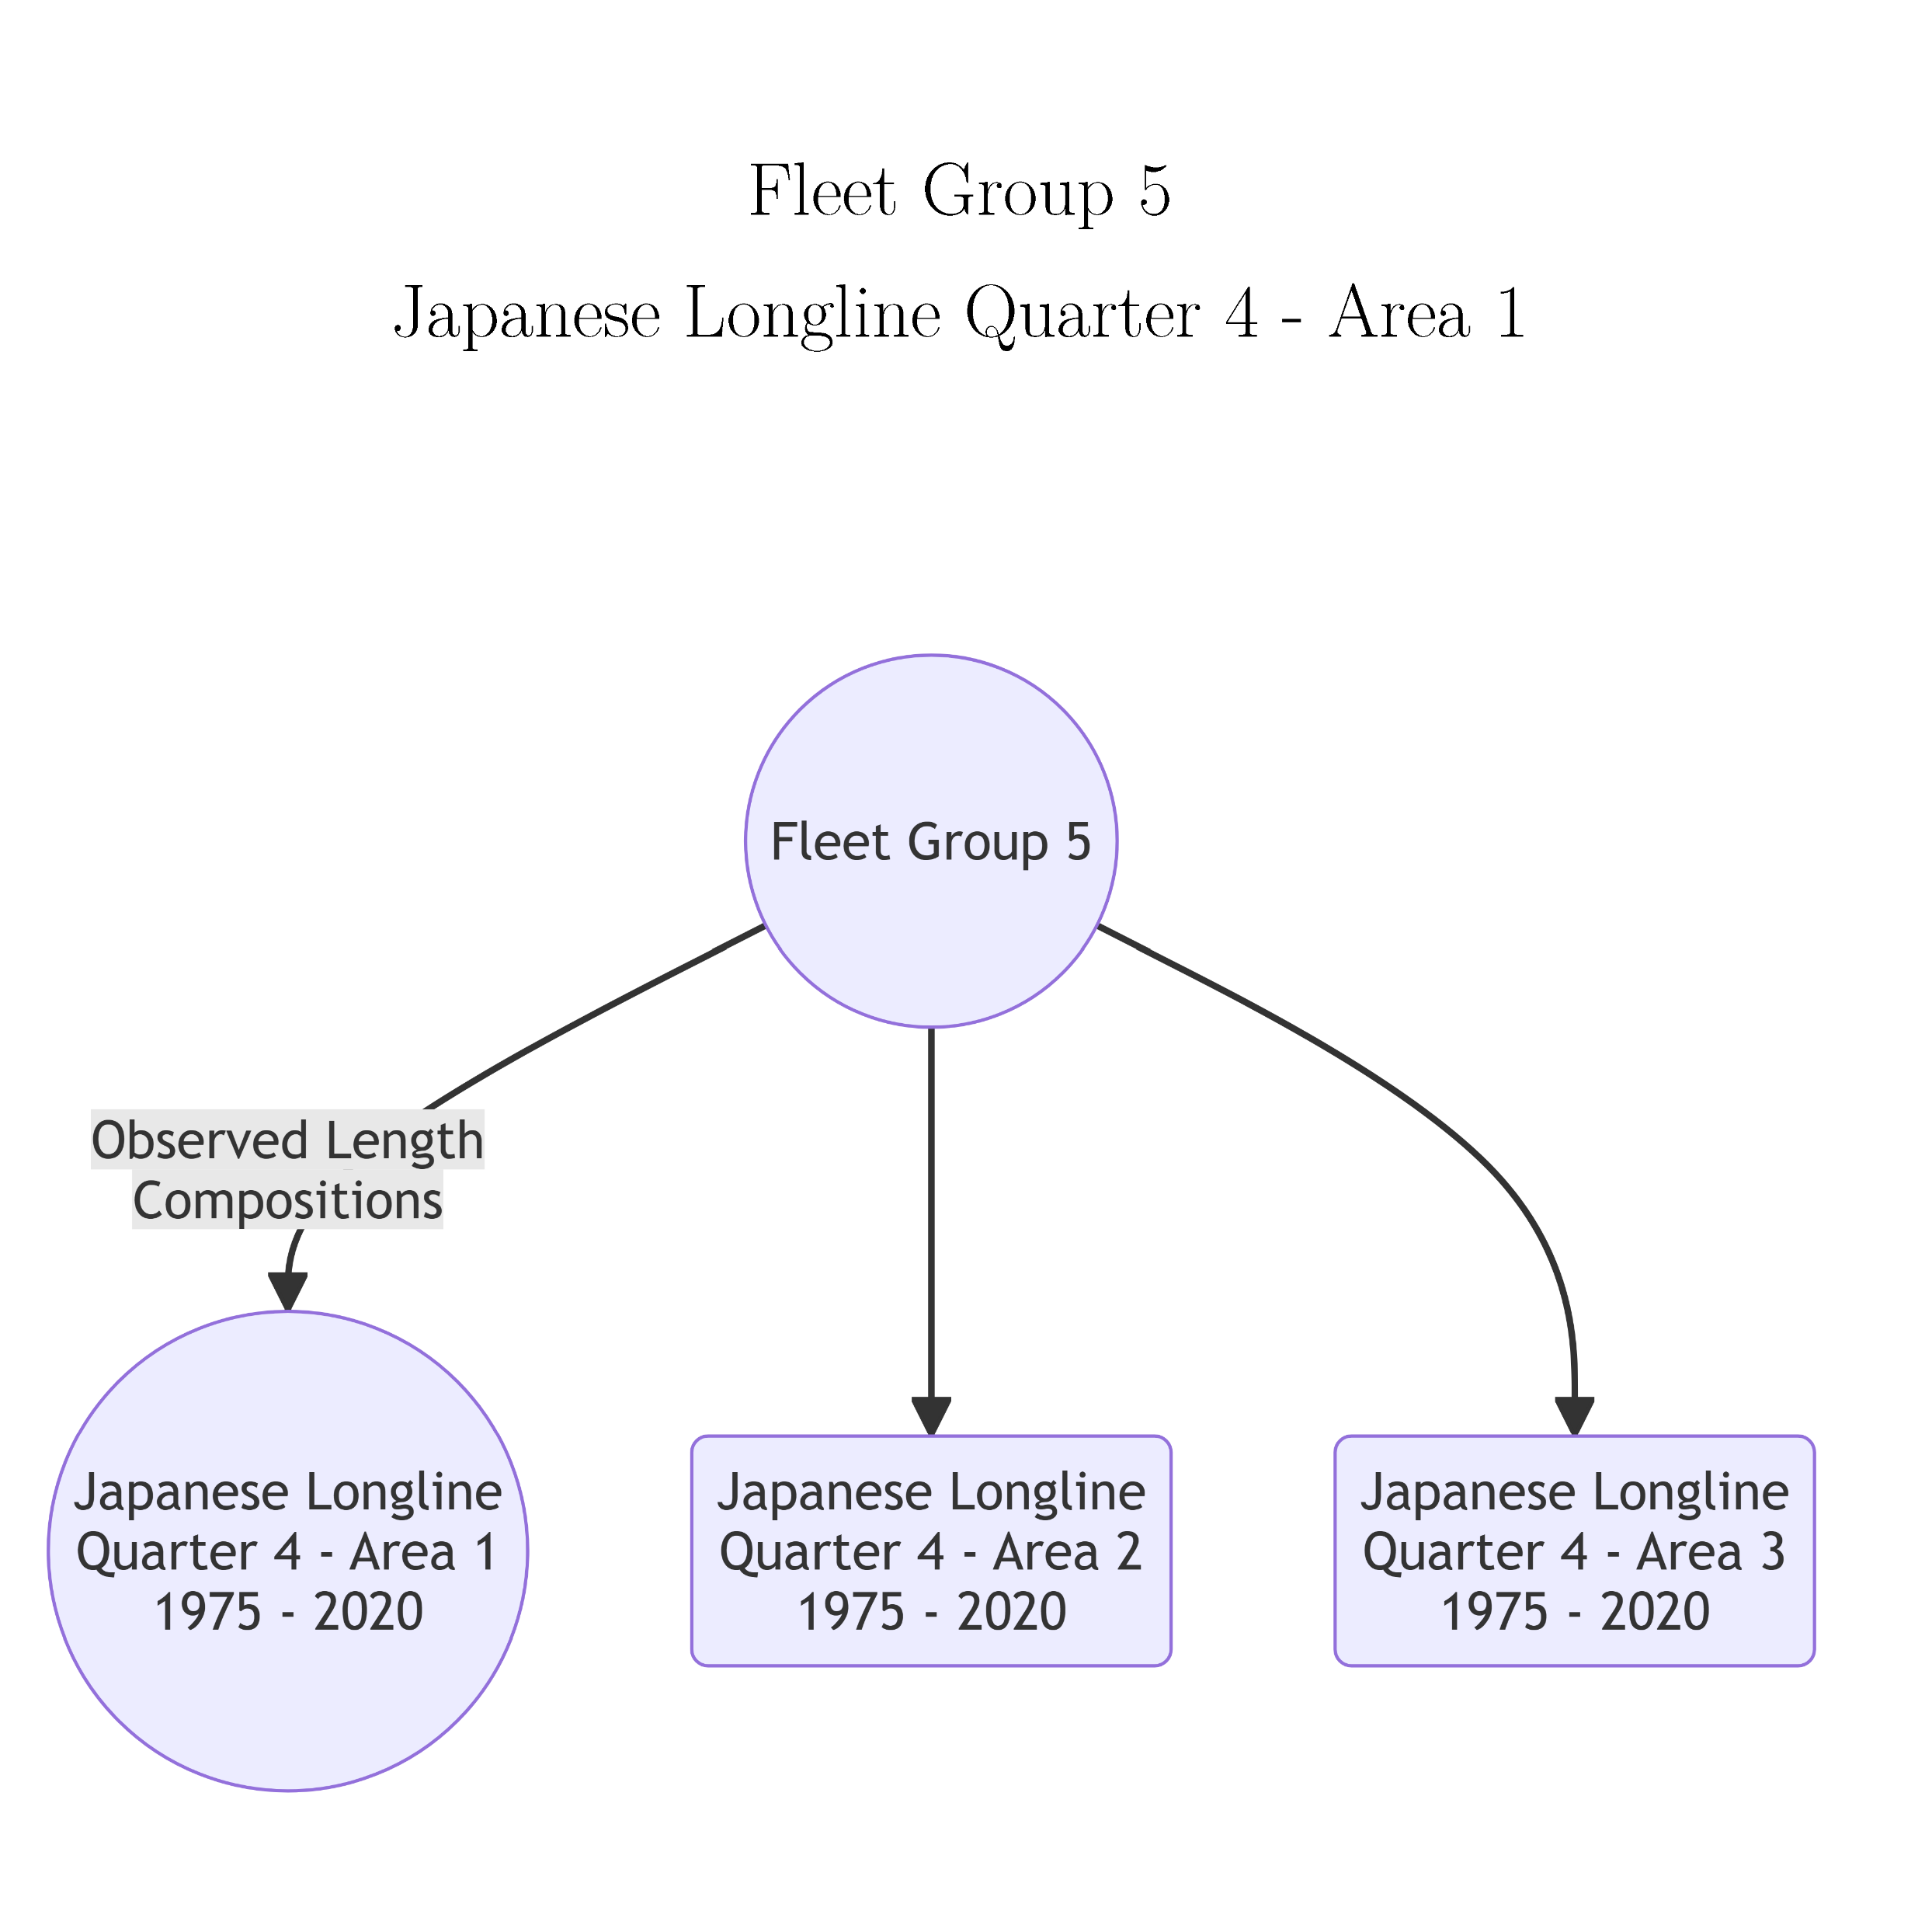
Fleet Groups with Identical Fishery Selectivity for Striped Marlin

Slide 66
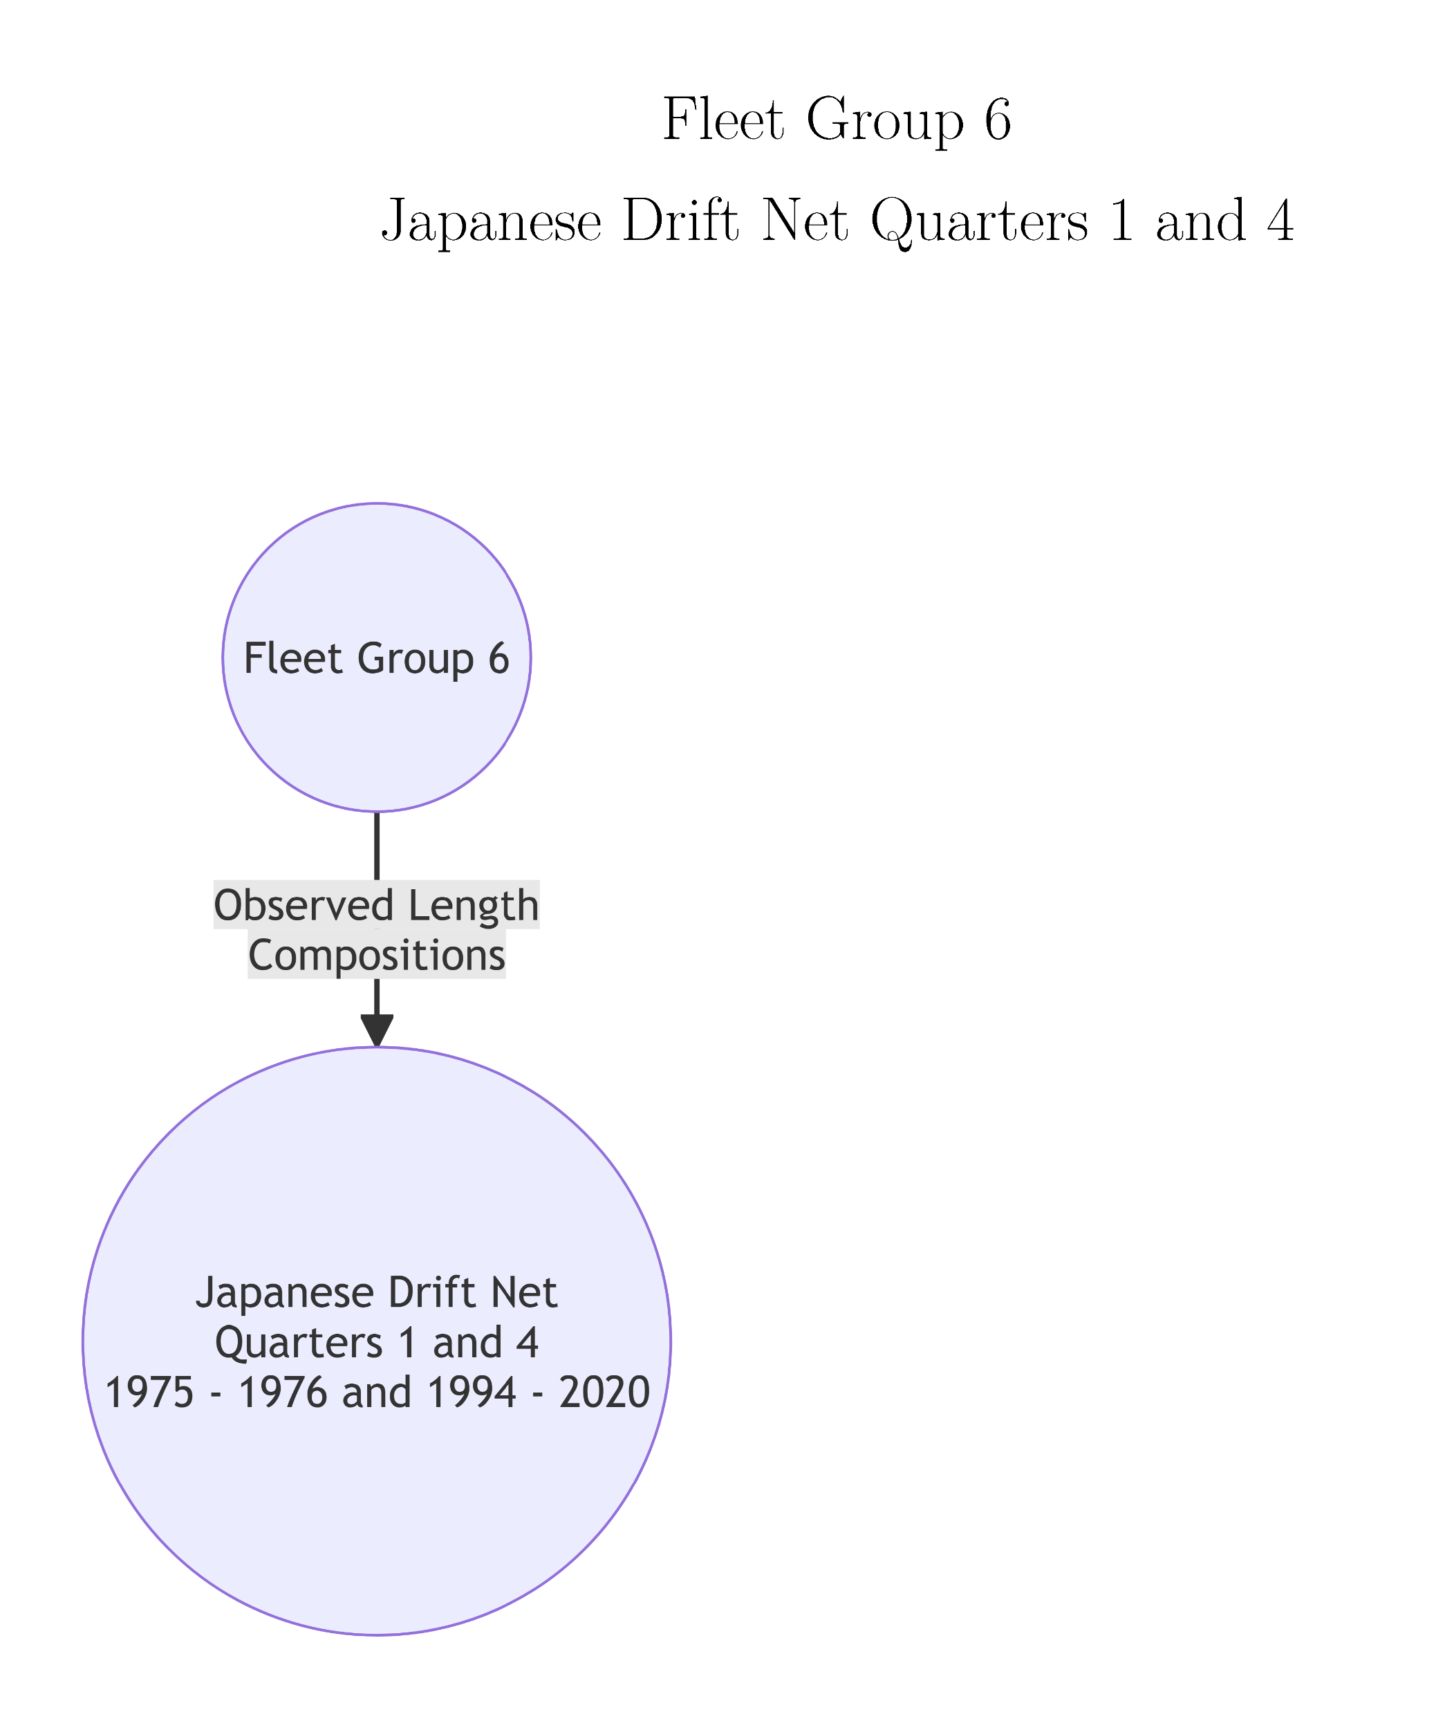
Fleet Groups with Identical Fishery Selectivity for Striped Marlin

Slide 67
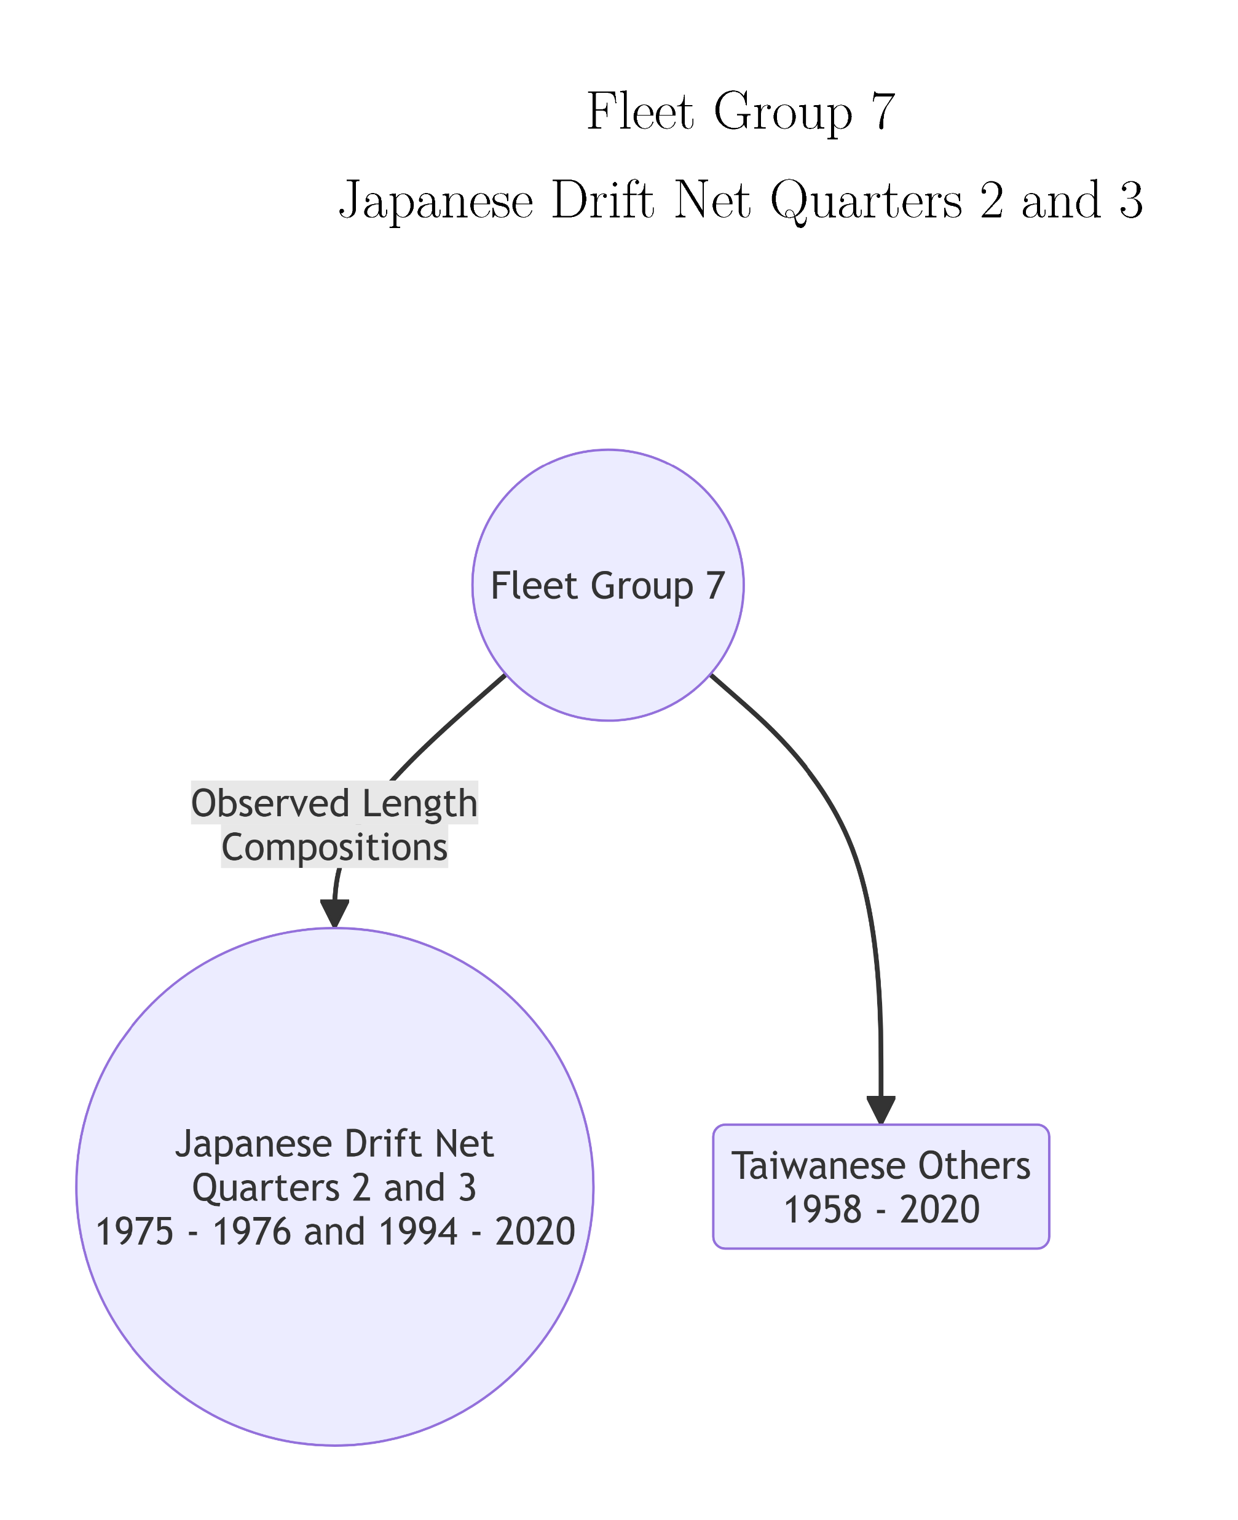
Fleet Groups with Identical Fishery Selectivity for Striped Marlin

Slide 69
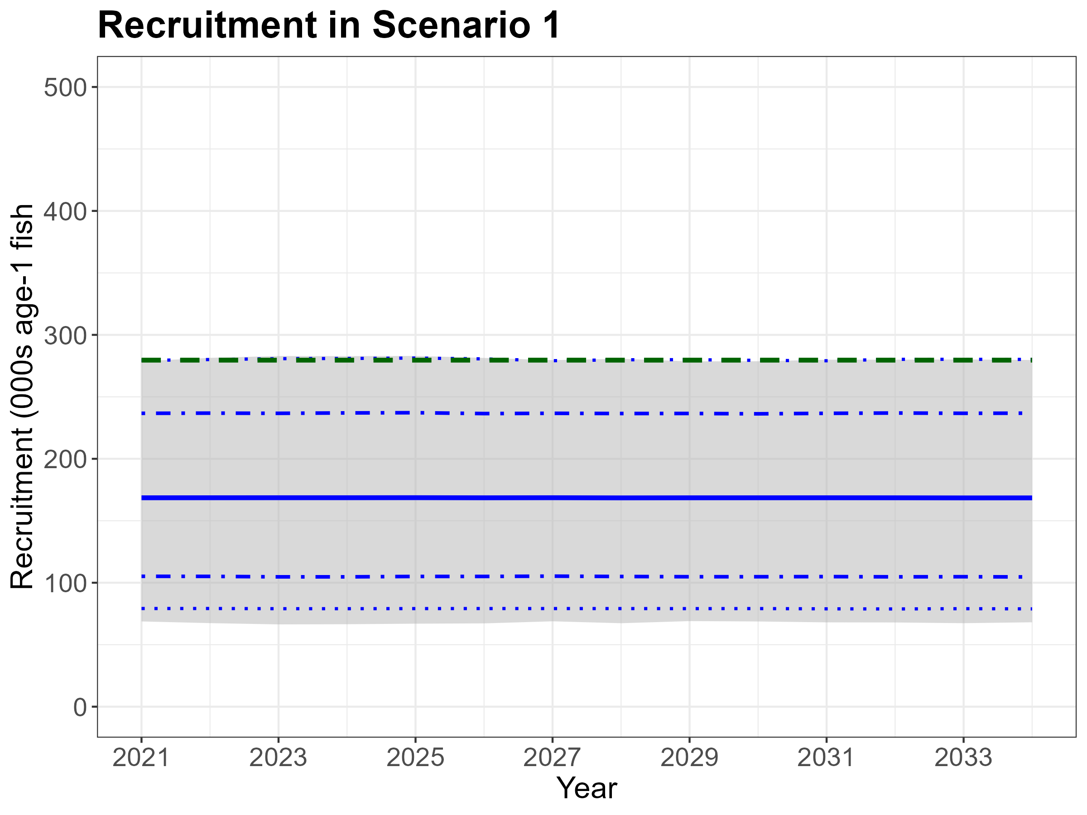

Slide 70

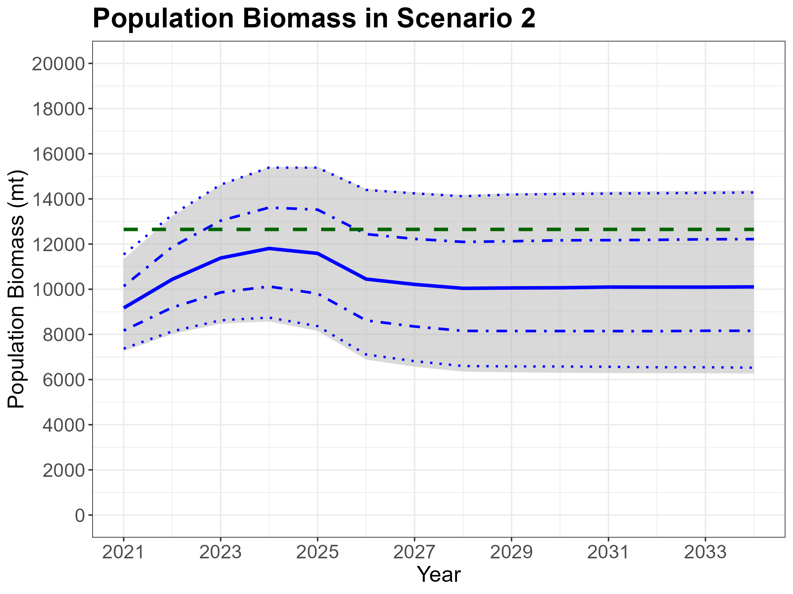

Slide 71


Slide 72


Slide 74
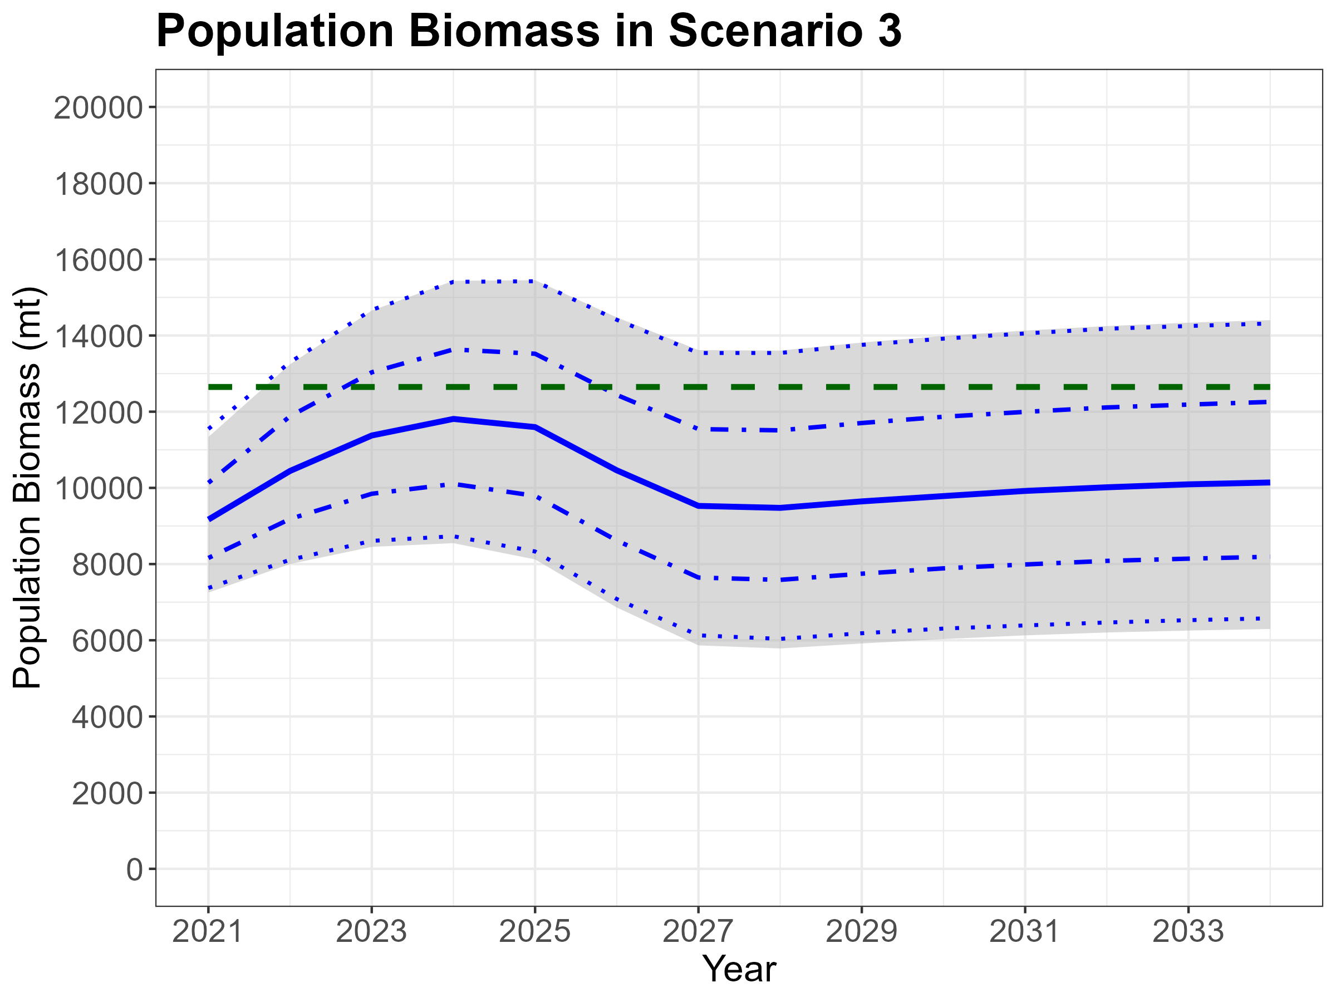

Slide 75
Initial Population Numbers at Age

Slide 77
Apportion MLS Catch to Fleet Groups from the 2023 Assessment

Slide 78
Reported MLS Catch from Japan

Slide 79
Reported MLS Catch from the United States

